Slide 1
"ZSE – the school of open minds" project as part of the ERASMUS + PROGRAM: Edukacja Szkolna / action 1 Educational Mobility, co-financed from the resources of the EUROPEAN UNION project No. 2017-1-PL01-KA101-036924
Location: Portugal, Braga

Slide 2
Participants of the trip:
Sławomir Dudek
Piotr Golonko
Krzysztof Kazarez
Roman Kuczaba
Marek Szyfman

Slide 3
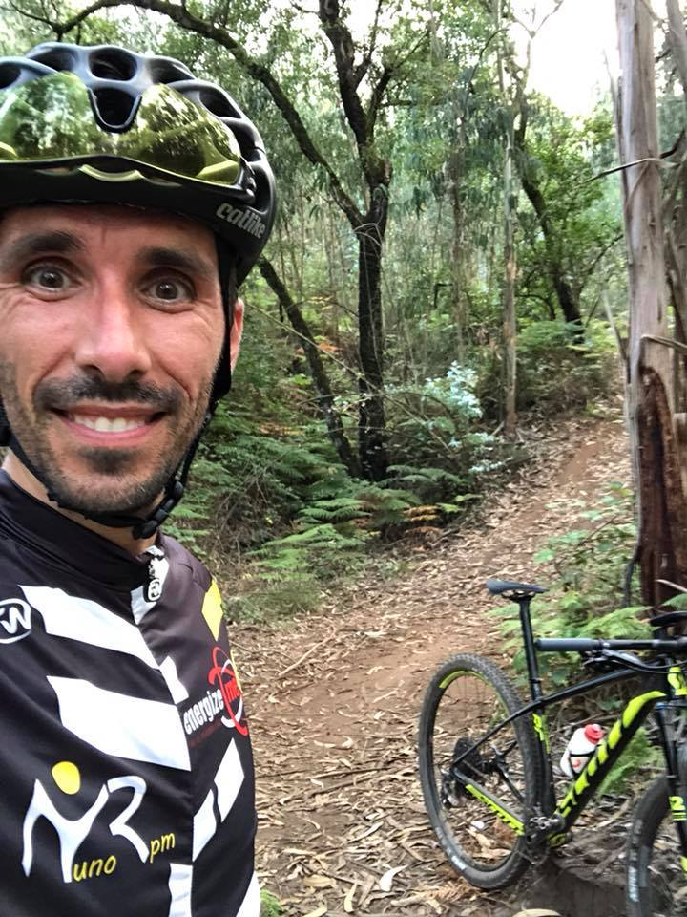
Moodle training and reverse teaching lasted 5 days (6 - 10 August 2018).
Classes were conducted by a Portuguese teacher Lino Onil (in English).
During breaks in classes he told us about his passion - cycling.

Slide 4
The training was divided into the following topics:
How to install the Moodle Software on a serwer,
How to Set Up Courses in Moodle,
How to Register User, Enrol Students, and Set Roles,
How to create quizzes,
Understand the principles of a Flipped Classroom,
Create Flipped Classes,
Adapt normal classes into Flipped Classes How to change from a traditional school the 21 century School.

Slide 5
Portugal

Slide 6
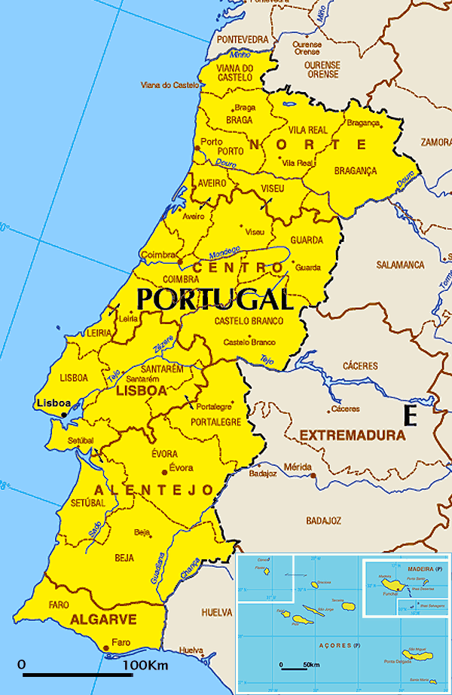
Capital: Lisbon (Lisboa)
Official language: Portuguese
Area: 92.090 km² (including Azores and Madeira)
Population: 10.8 million
Currency: euro, symbol: €
Land borders: Spain: 1214 km? total: 1215 km
The length of the coast: total: 1793 km

Slide 7
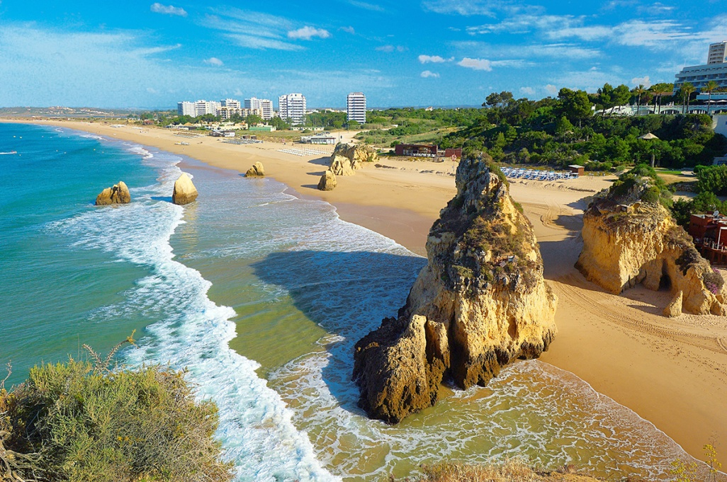
Portugal is located in the Mediterranean oceanic climate zone.
Average air temperature is as follows:
January 5°C and July 29°C - in the interior of the country
January 8°C and July 20°C North coast
- January 11°C and July 26°C south coast

Slide 8
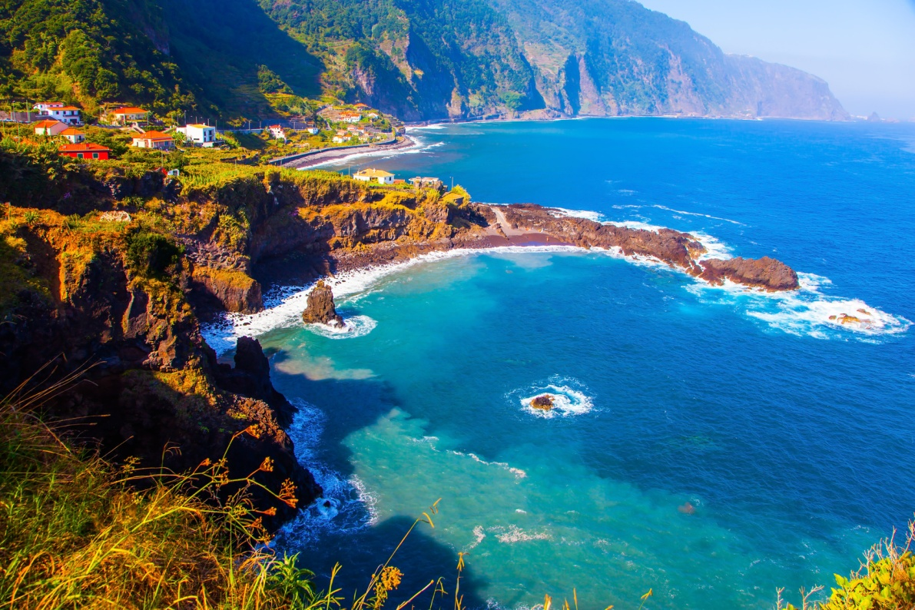
In the north, mountainous and upland areas prevail.
Mountain ranges:
Serra do Larouco (1525 m above sea level),
Serra do Marão (1415 m above sea level),
Serra da Estrela (1993 m above sea level).
The south is dominated by the lowland-highland landscape. Closer to the sea, the heights of Alentejo and the Algarve extend. Coast in the southern part of the cliffs, in the remaining area covered with dunes and lagoons.

Slide 9
Flag
Emblem

Slide 10
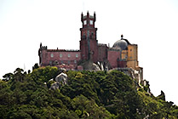
Although according to statistics ¾ Portuguese population live in the countryside and through for many years there were only two big cities: Lisbon and Porto, the last ones times the country is developing very dynamically and many other places strives to catch up with metropolises.
Lizbona - 770 000 residents
Porto - 307 000 residents
Amadora - 181 000 residents
Setúbal - 103 000 residents
Funchal - 115 400 residents
Braga - 63 000 residents
Coimbra - 60 000 residents

Slide 11
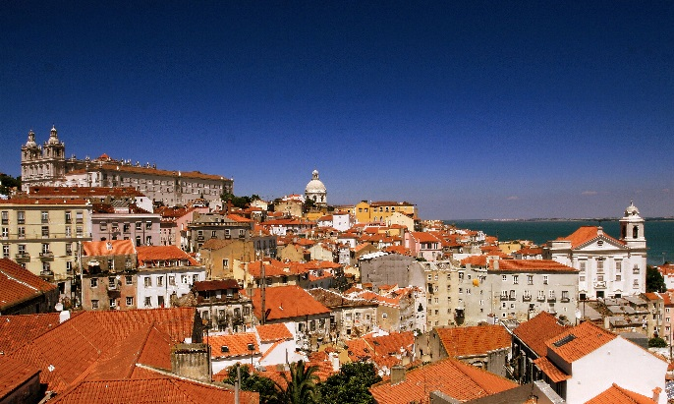
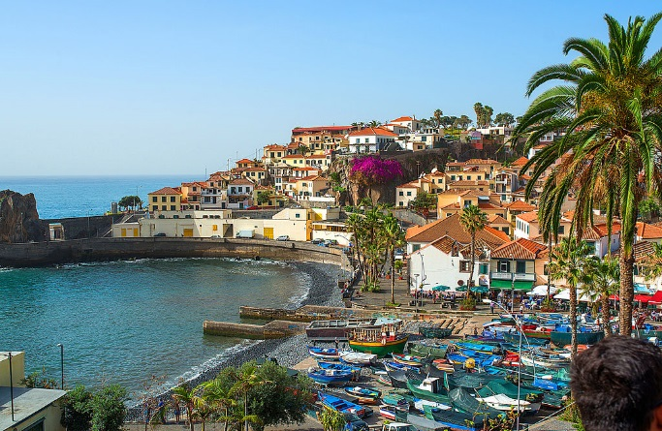
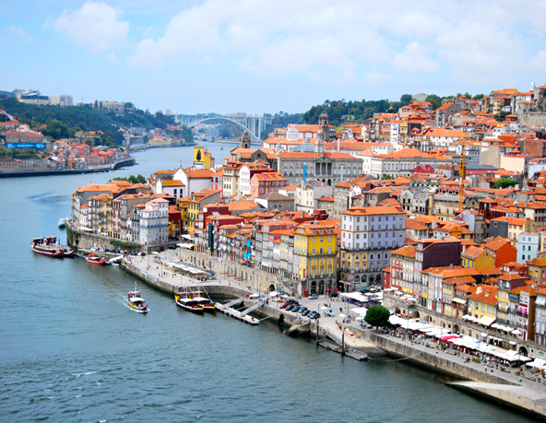
Portugal is far away, so the natural question is: why is it worth visiting? The country is interesting tourist. It is diverse, with mild air temperatures near the ocean - around 27°C, and hot in the depth - around 40°C. Atlantic beaches are very picturesque, usually cliff, sandy, the water is very clean, although rather cool - on the Alentejo coast in summer 18°C - 20°C, Algarve 22°C - 23°C.

Slide 12
1300 km from the west coast of Portugal, lies the nine volcanic islands that make up the Azores Archipelago known for its extraordinary scenery, lush vegetation and peaceful lifestyle of its inhabitants. Once wild and unavailable, they are now a popular destination for hiking and sailing. With a small number of beaches and large resorts, capricious and often humid climate, the Azores managed to avoid mass tourism.

Slide 13
CURIOSITIES

Slide 14
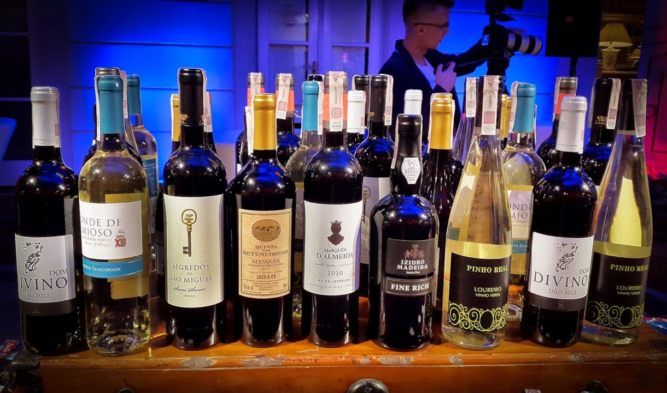
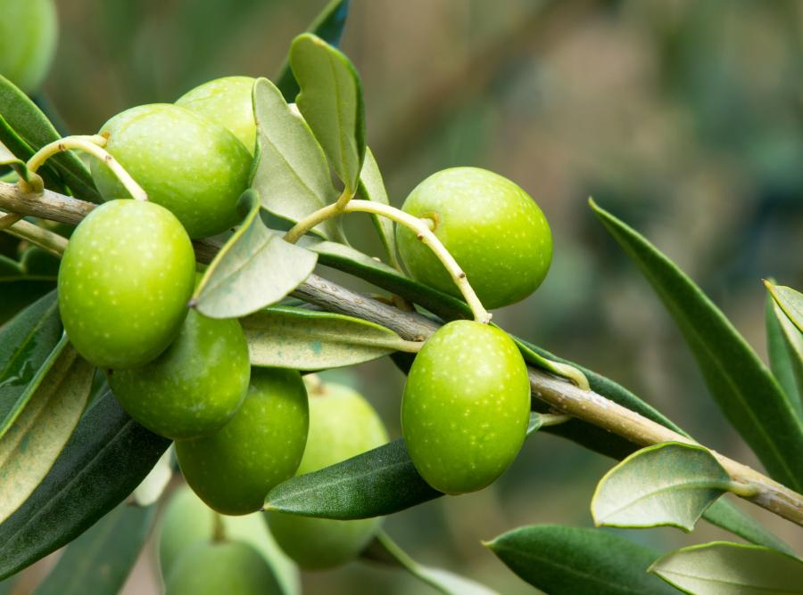
Portugal is one of the leading producers of wine, olives and cork, which gives respectively 8%, 5% and 50% of world production. Cork forests occupy as much as 600,000 ha of the country's area.

Slide 15
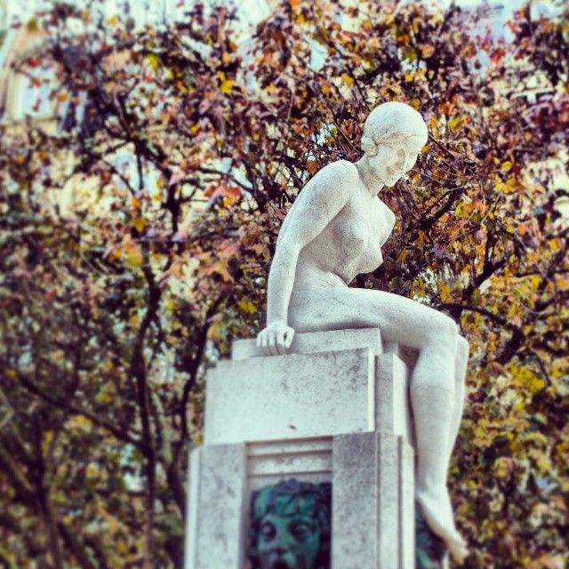
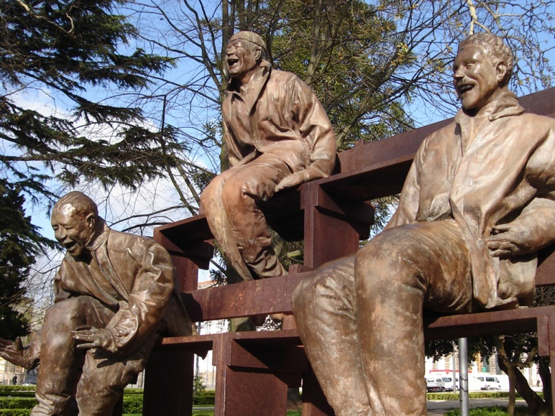
In Portugal, the generally accepted manner of polite addressing are the forms a senhora (lady) and senhor (gentleman), the young person should be addressed and the menina (young lady). In looser contacts you can use the word você, which means more or less "you", but it is used for people who are weak or unfamiliar.

Slide 16
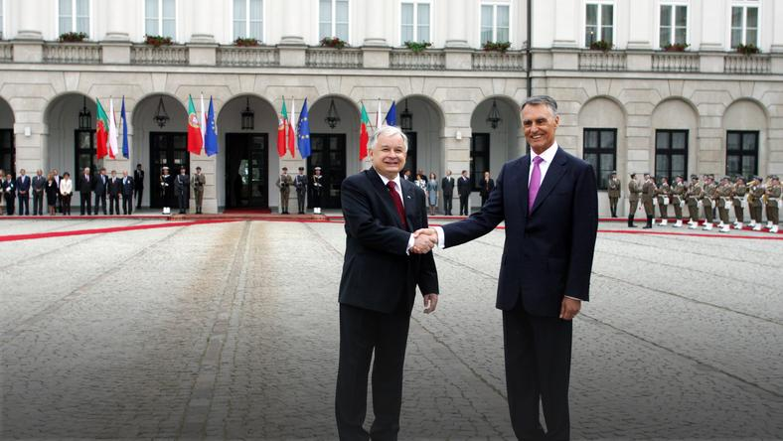
It is worth remembering that giving a hand to greet is in Portugal a gesture reserved for men. Women and children are greeted with a double kiss.

Slide 17
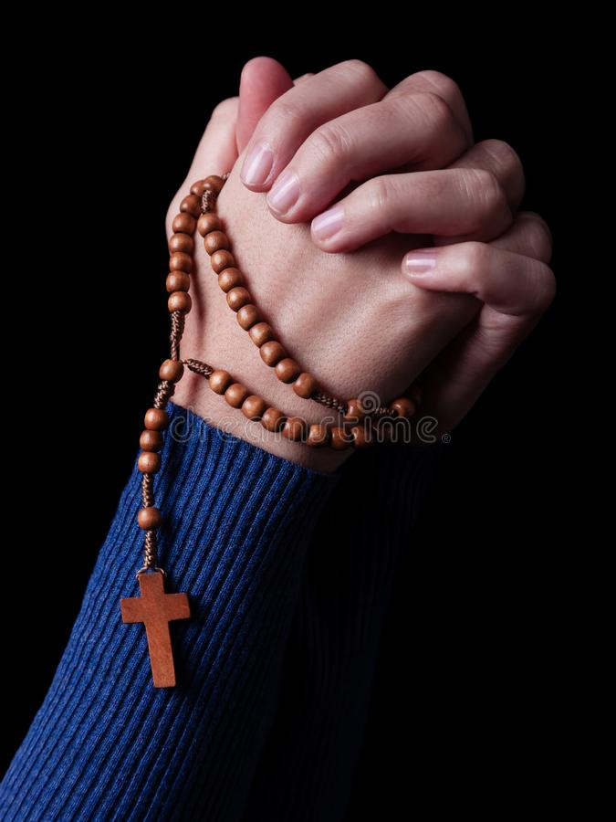
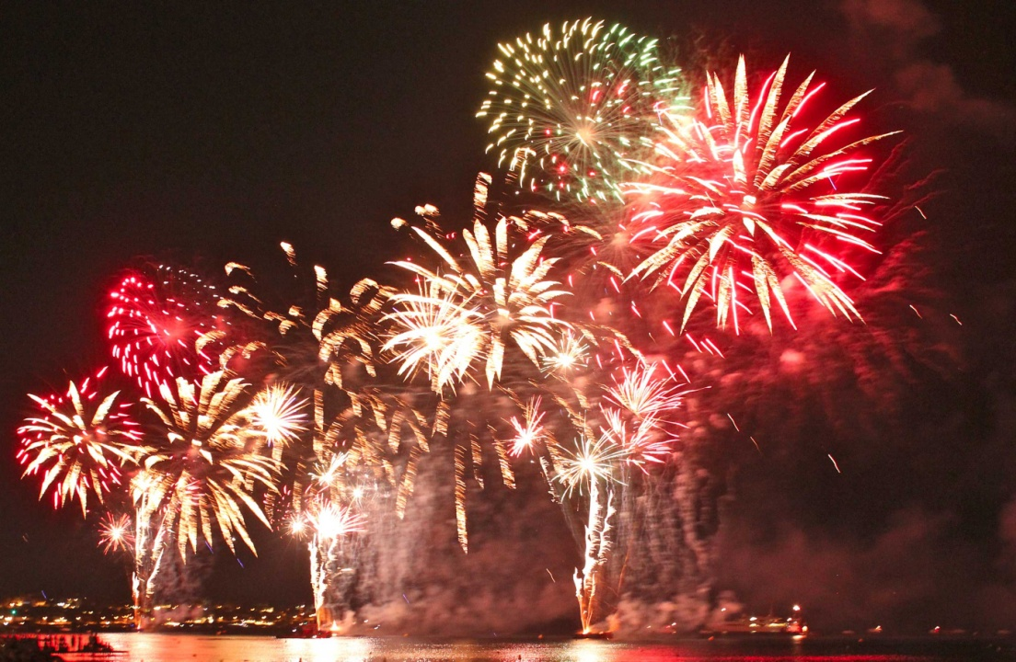
Portugal has several major cities that its residents often joke about: "they pray in Braga, work in Porto, study in Coimbra, and live in Lisbon."

Slide 18
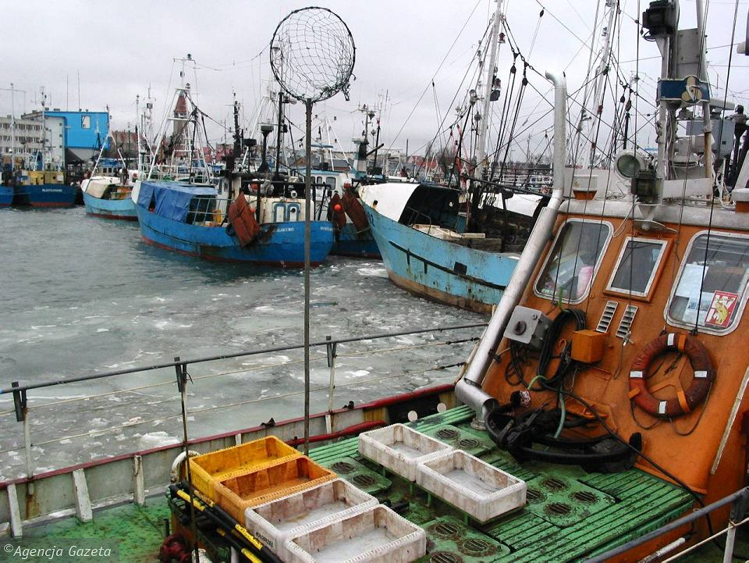
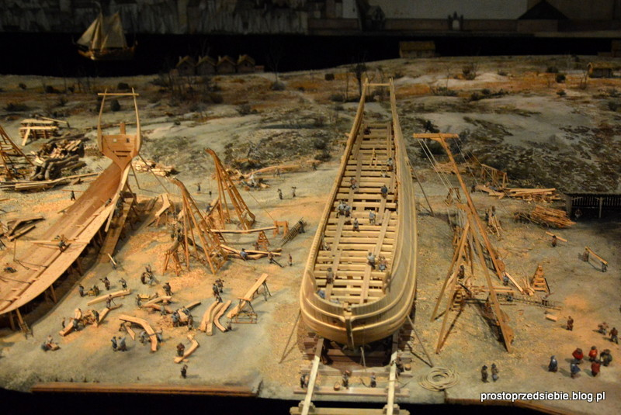
In many parts of Portugal, you can meet with the continuation of the traditional lifestyle of the "nation of fishermen, ship builders" and merchants "that the Portuguese have been for centuries.

Slide 19
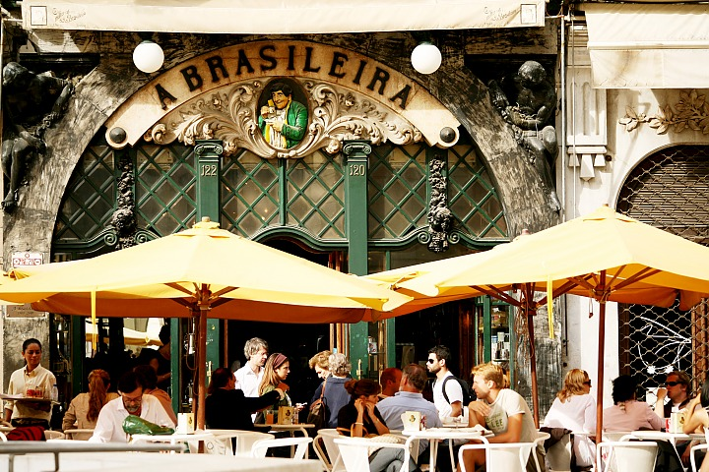
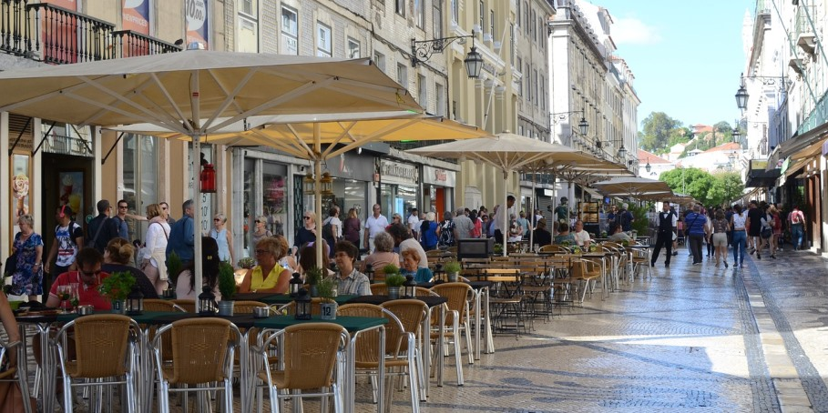
Portuguese cafes, unlike our Polish ones, are open from the very morning. In this country, bars and restaurants are not associated only with night life, many Portuguese people tend to eat breakfast and afternoon tea.

Slide 20
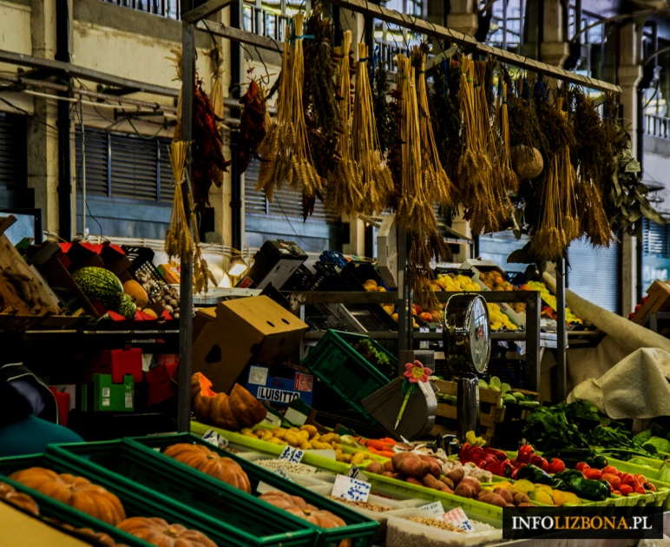
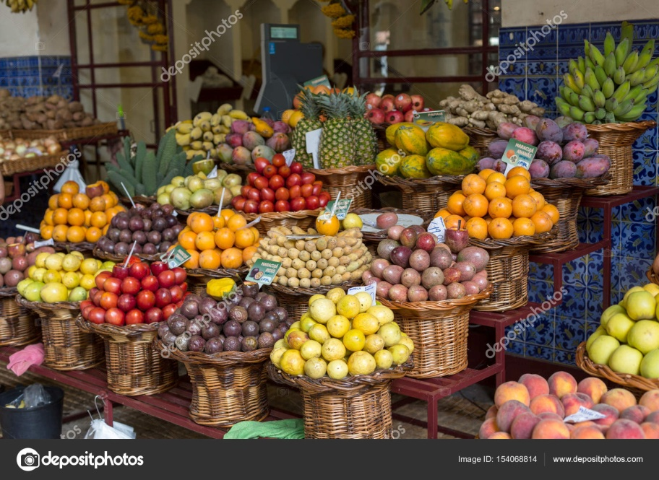
Mercados - these are the famous Portuguese markets and bazaars, the visit of which can be compared to a great adventure. Especially the eyes of a foreigner will delight here tons of exotic fruits, chili braids, as well as unknown species of fish and seafood.

Slide 21
By the way, an important Portuguese word - obrigado, i.e. thank you ...

Slide 22
Travel to Portugal

Slide 23
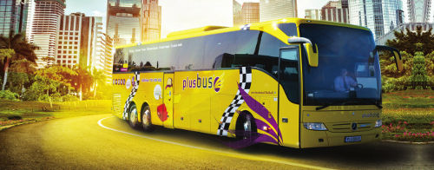
Our trip to Portugal began in Bialystok.
We went to Warsaw to the airport by bus from the PlusBus line.

Slide 24
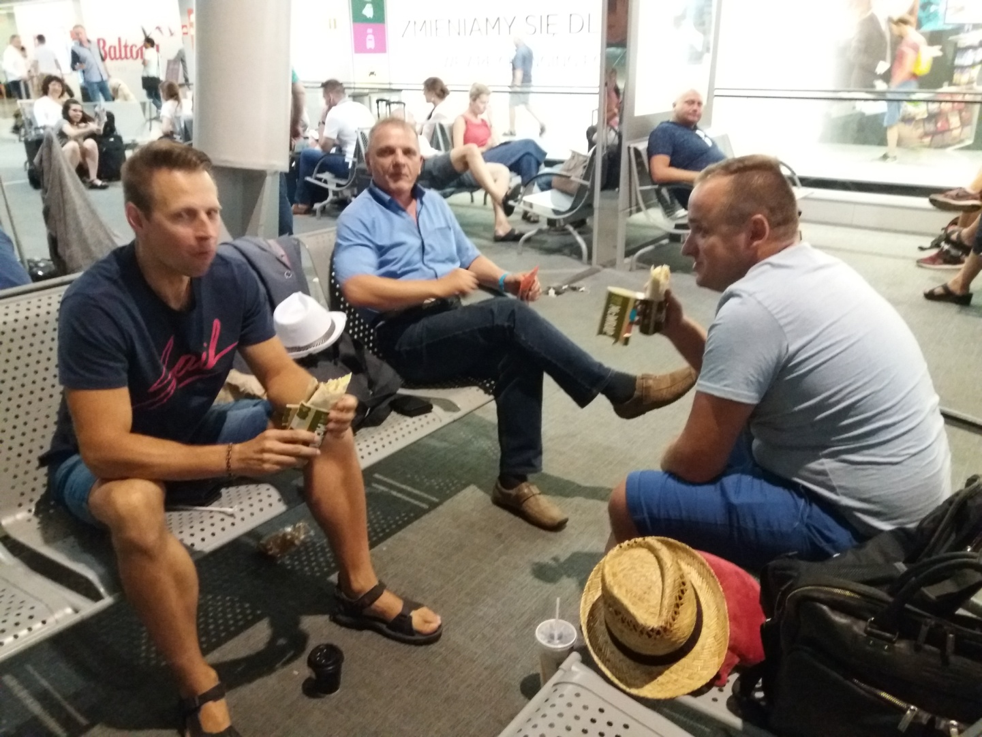
At the airport, we waited hungry for a late flight that took off after midnight.
A night flight awaited us.

Slide 25
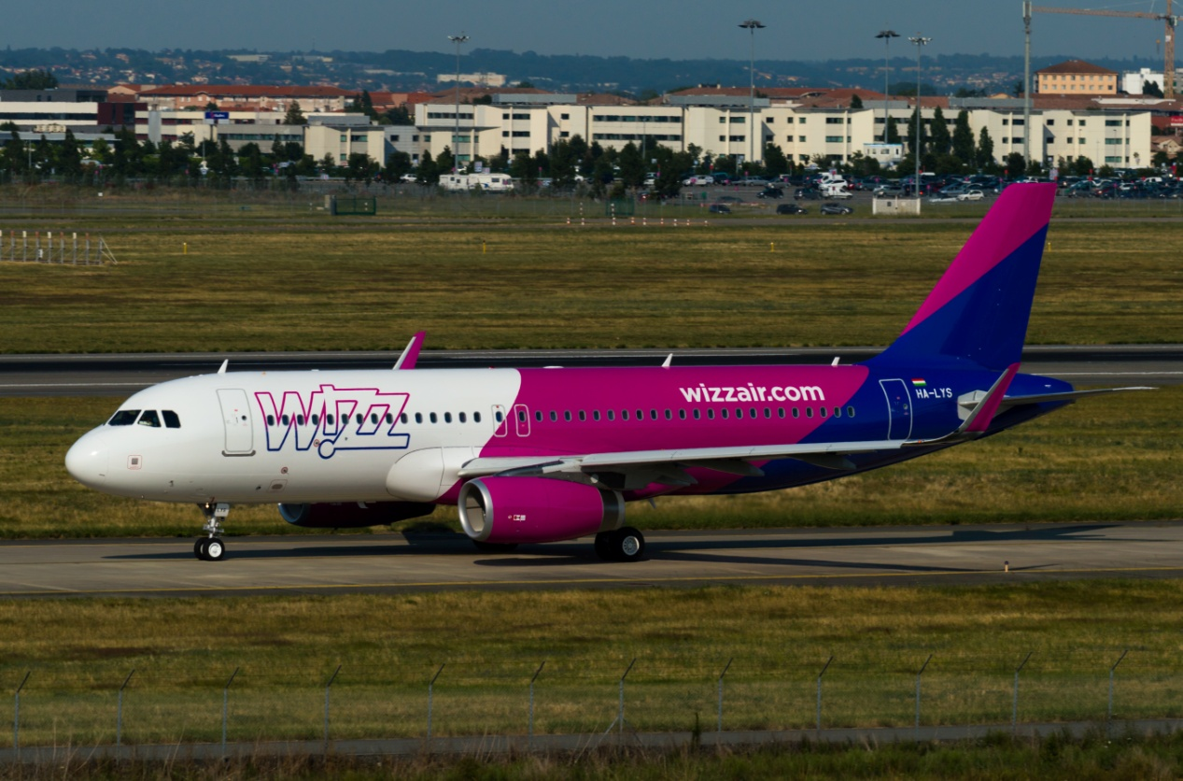
At the end of the morning, we landed at the airport in Porto.

Slide 26
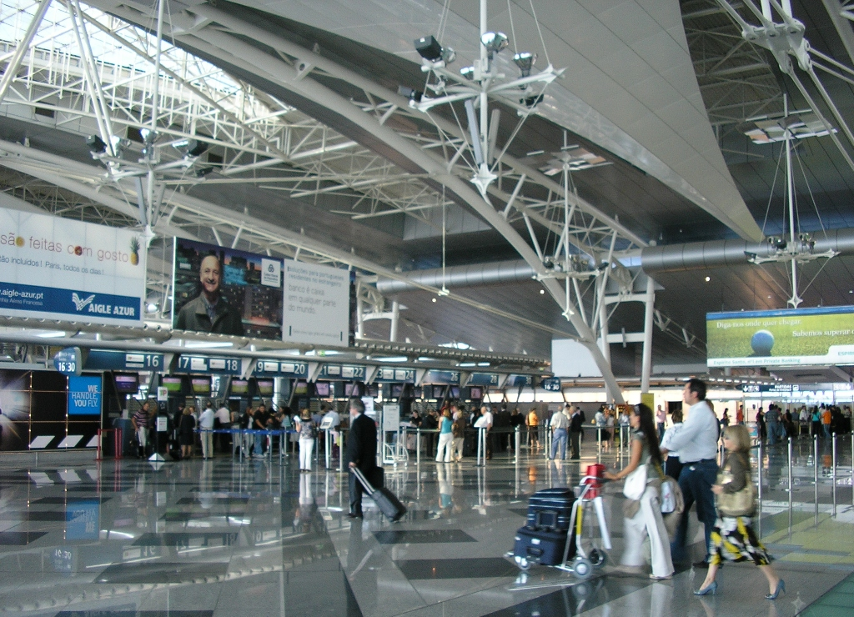
After picking up the luggage at the airport, we changed to a bus to get to Braga, to our hotel.

Slide 27
Hotel

Slide 28
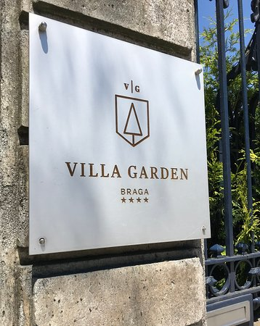
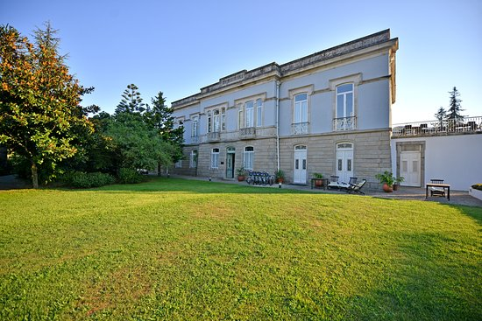
Hotel VILLA GARDEN where we stayed (Fortunately there was air conditioning in the rooms).

Slide 29
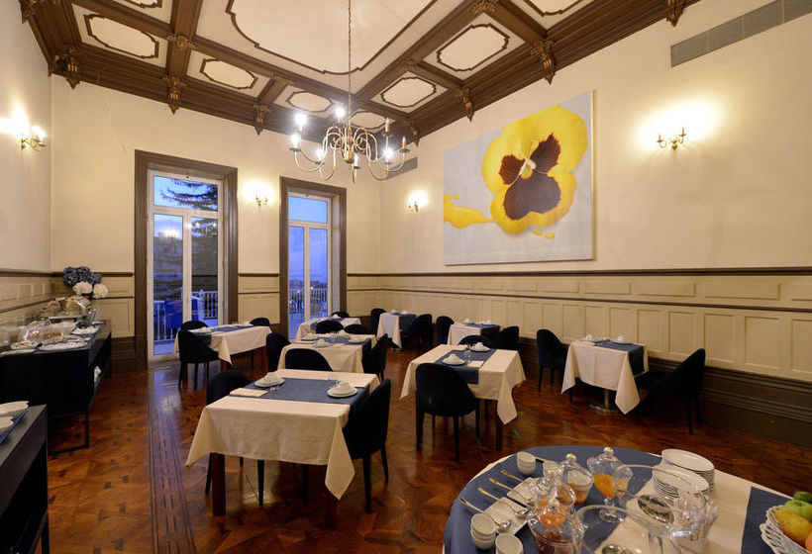
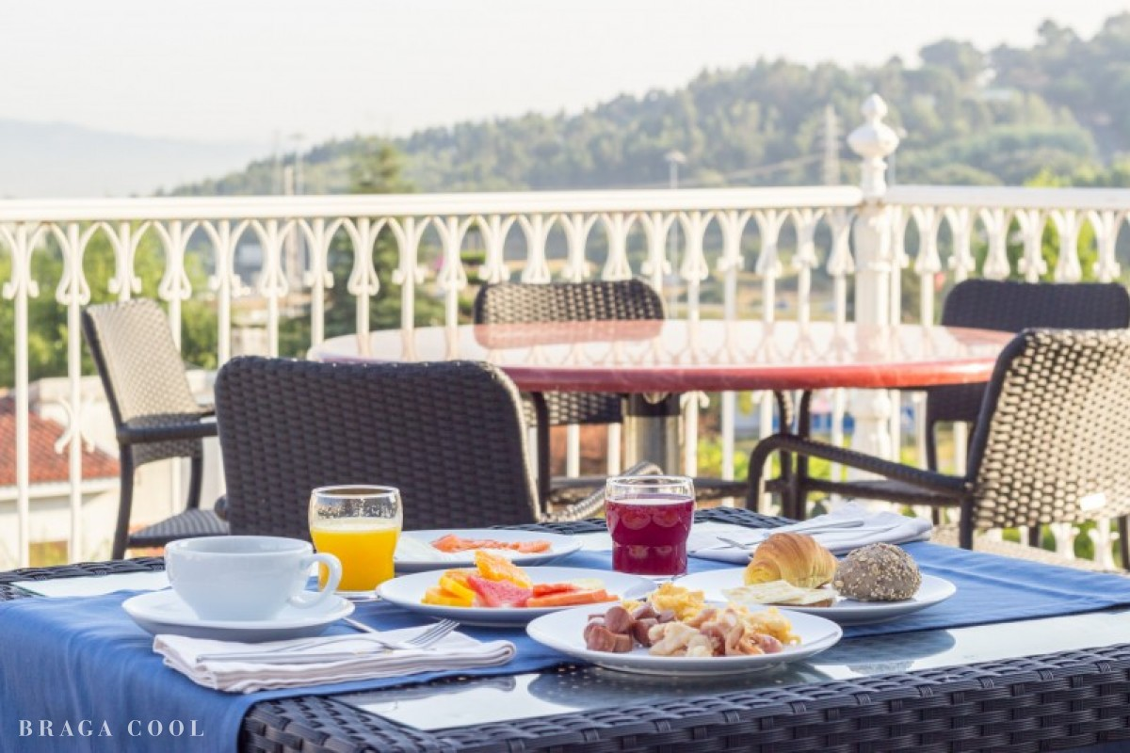
Our place where we ate breakfast at the hotel.

Slide 30
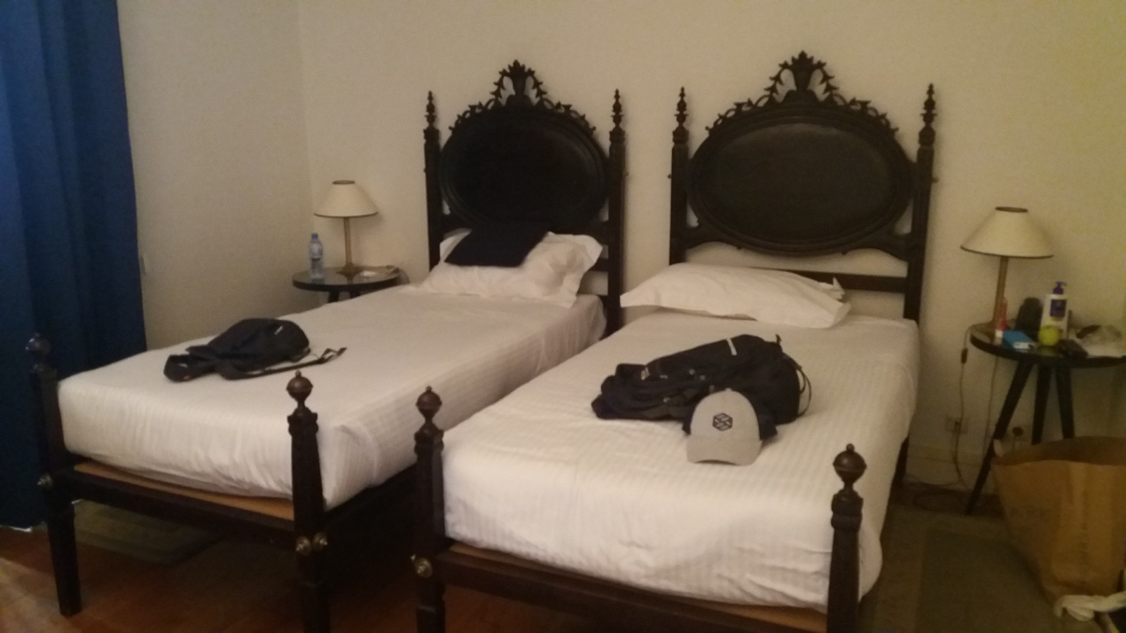
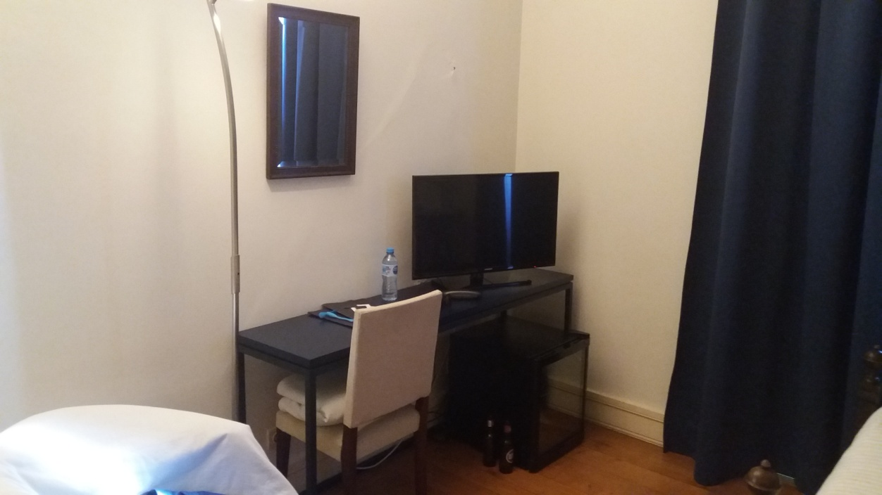
That was one of the hotel rooms.

Slide 31
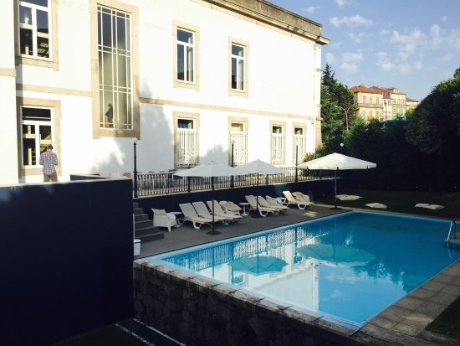
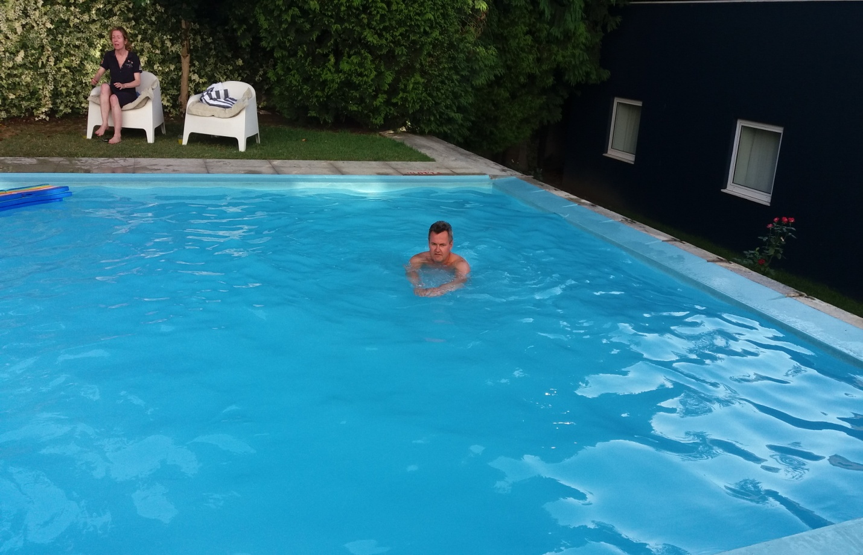
The hotel had a pool which we often used.

Slide 32
Our meals

Slide 33
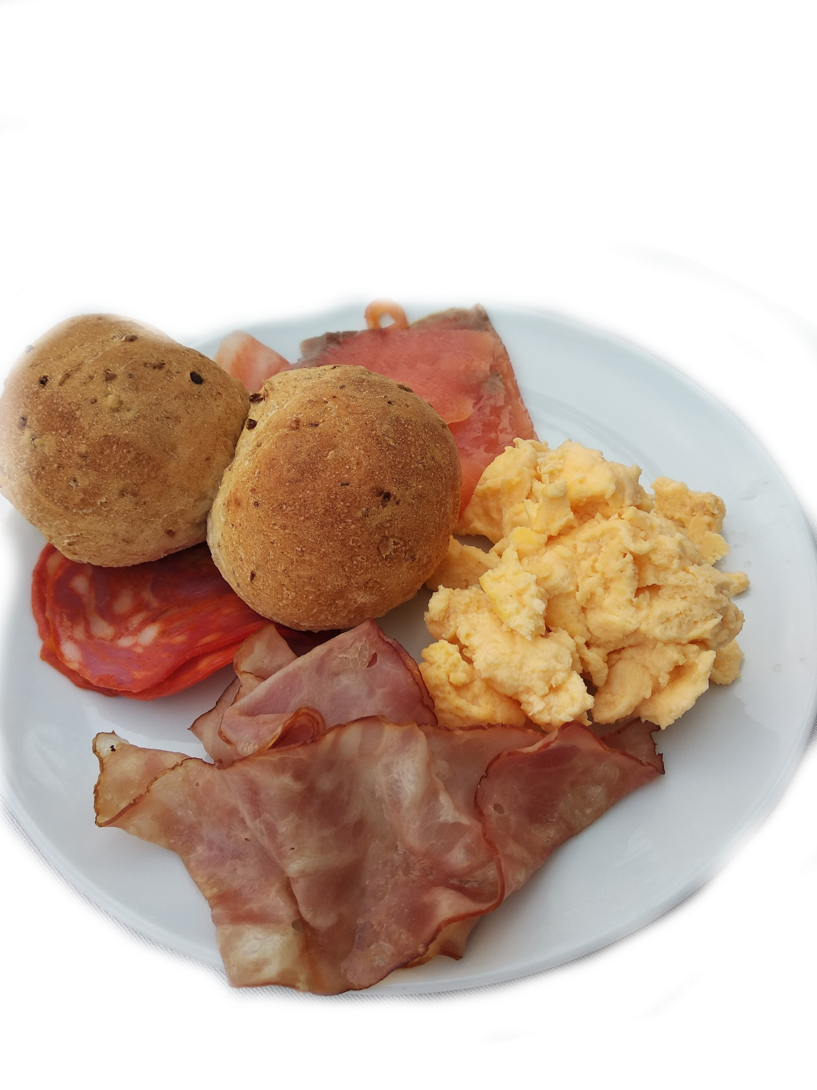
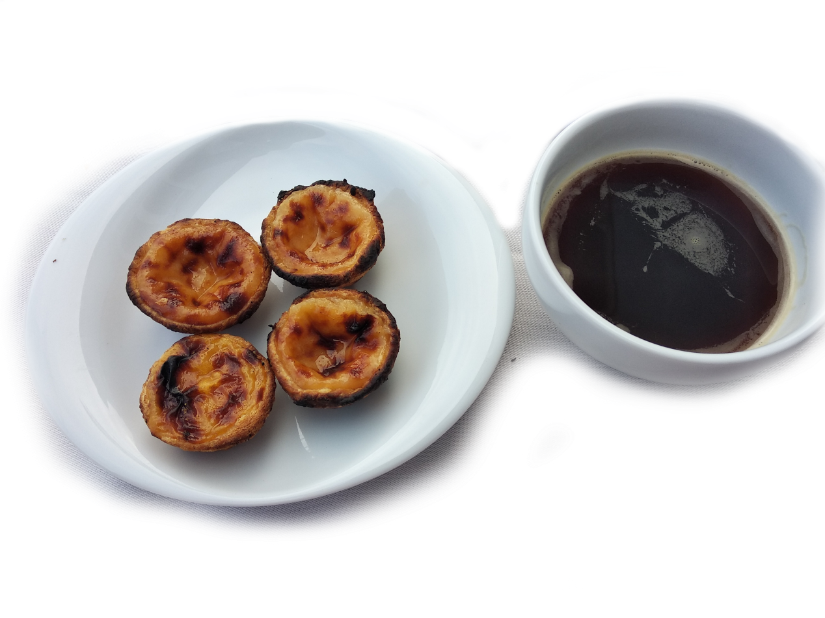
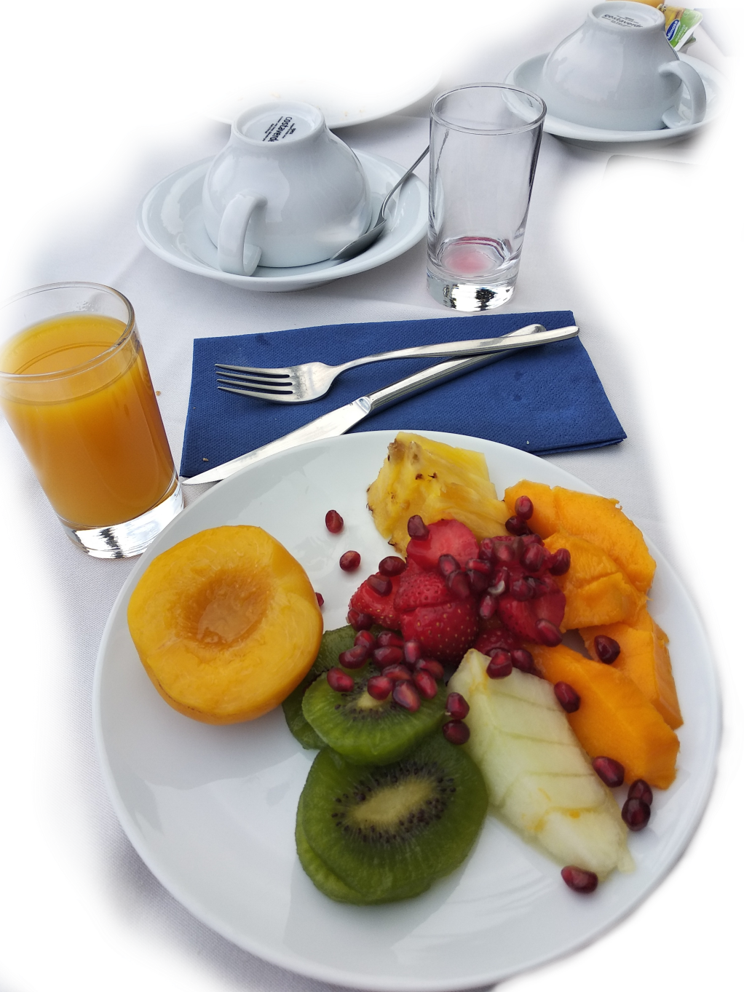
BREAKFAST
Local products were edible
Coffee instead of sleep
The cupcakes were yummy
Fresh fruit, sometimes from a can

Slide 34
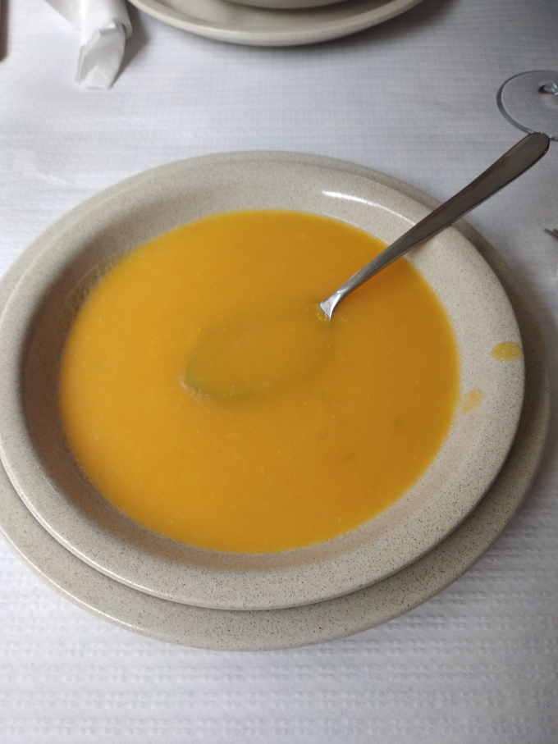
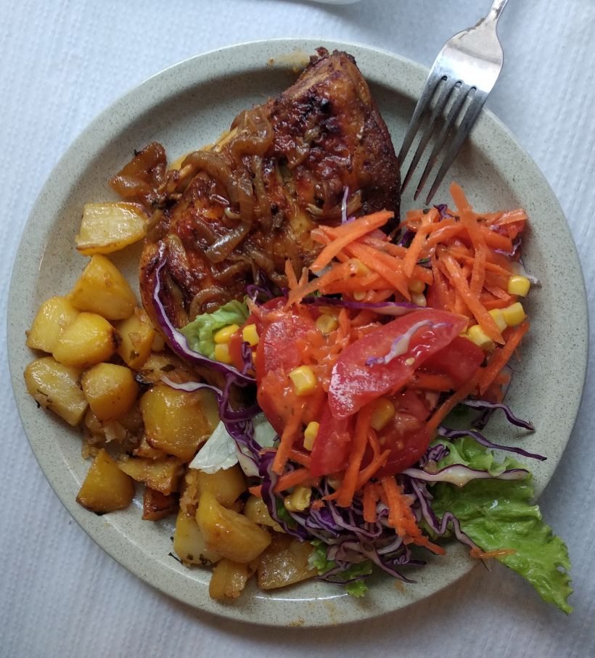
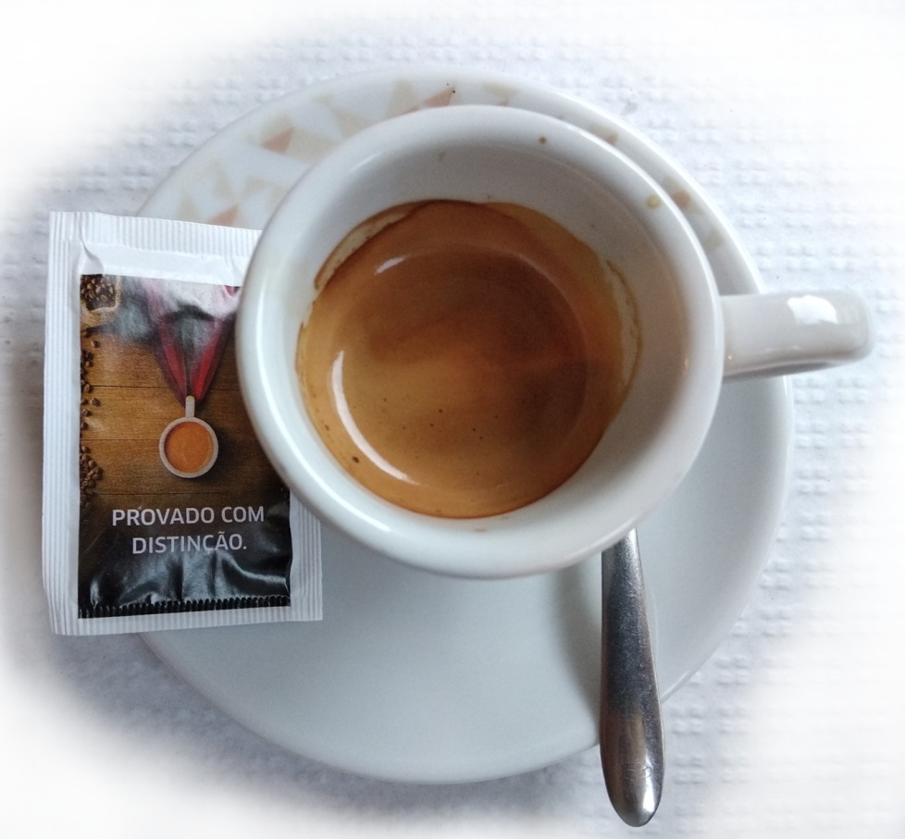
3-COURSE DINNER AND COFFE ☺
Espresso ☺
Soup, tasted better than it looked
Main course, always delicious
There was dessert! but did not survive

Slide 35
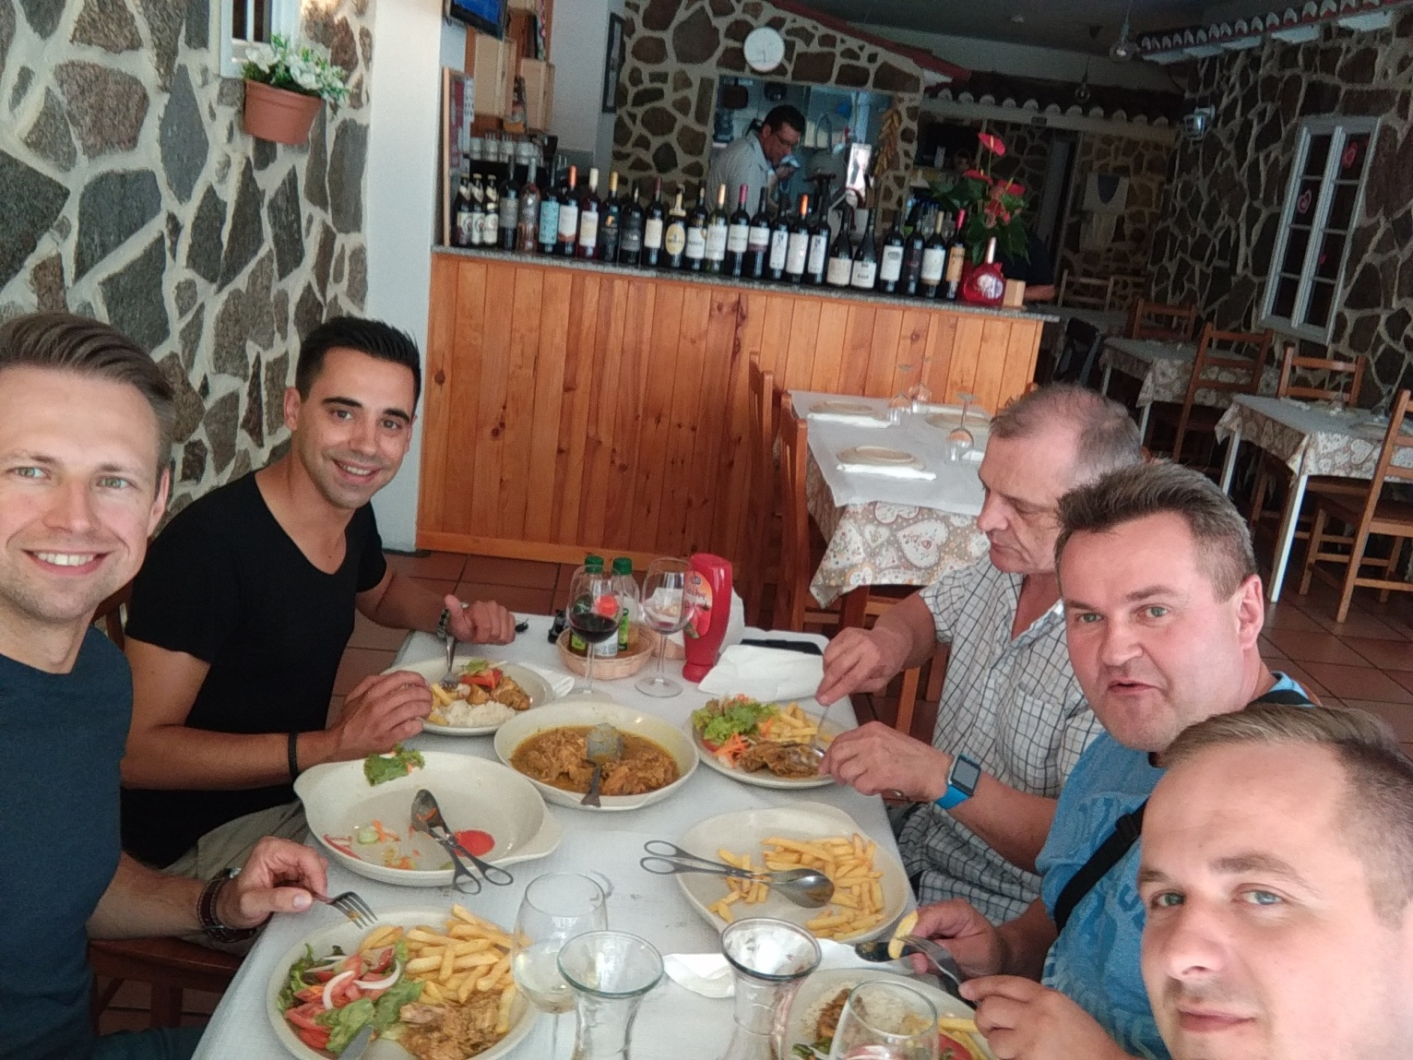
SUPPER
Supper was analogous to dinner :)

Slide 36
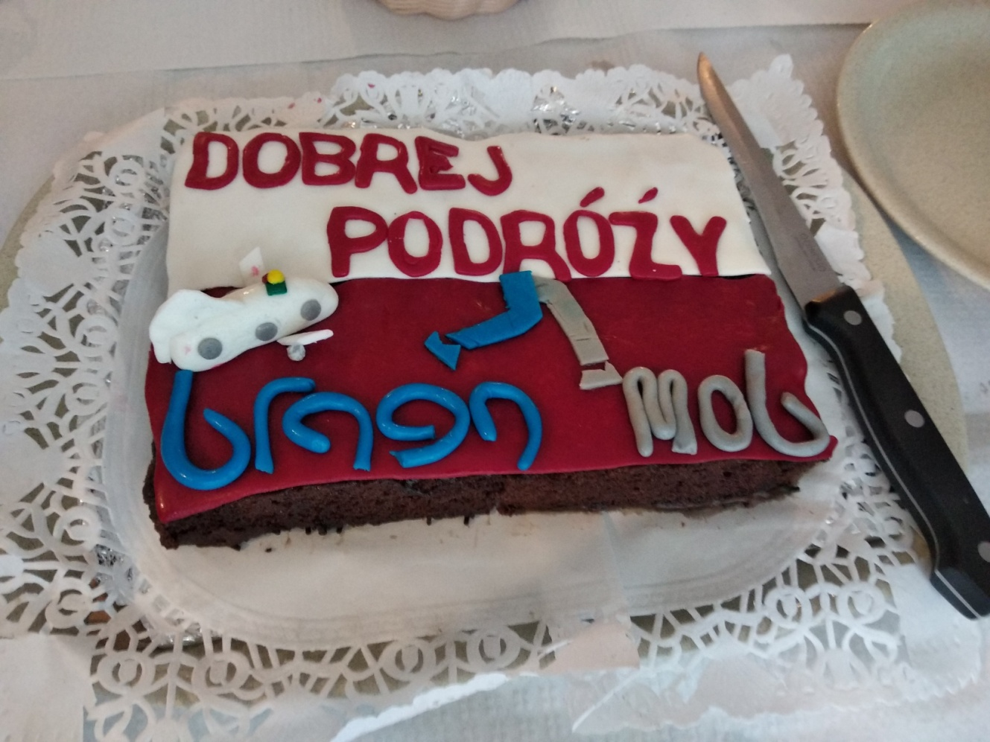
SURPRISE OF THE LAST DINNER

Slide 37
Training

Slide 38
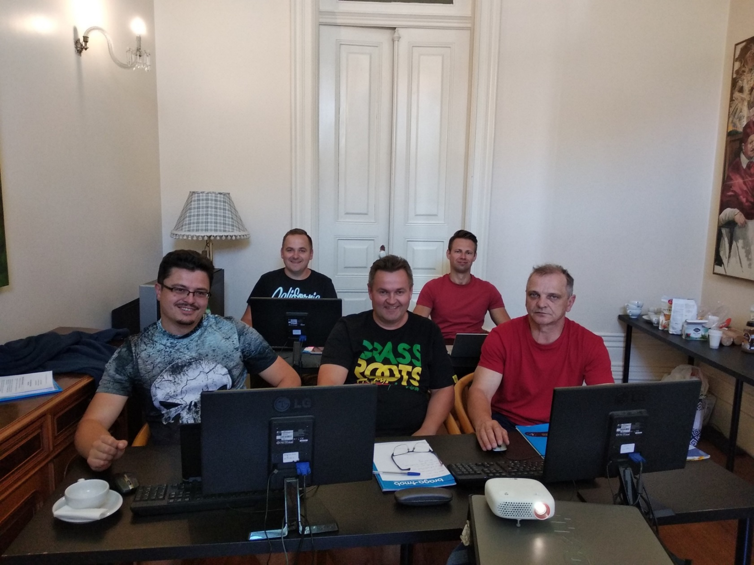
COURSE

Slide 39
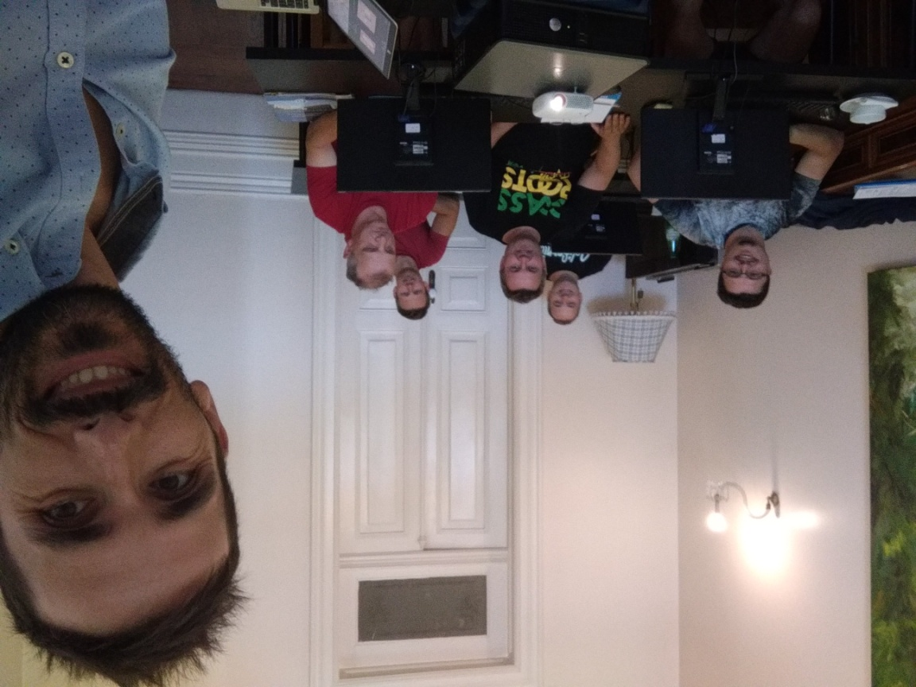
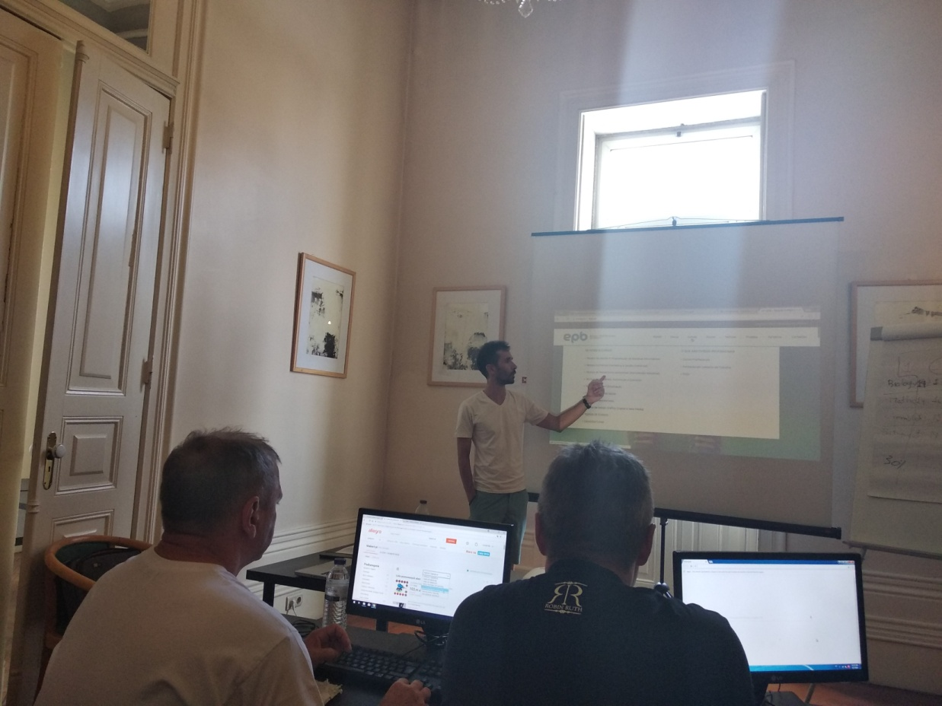
OUR TEACHER

Slide 40
Tours

Slide 41
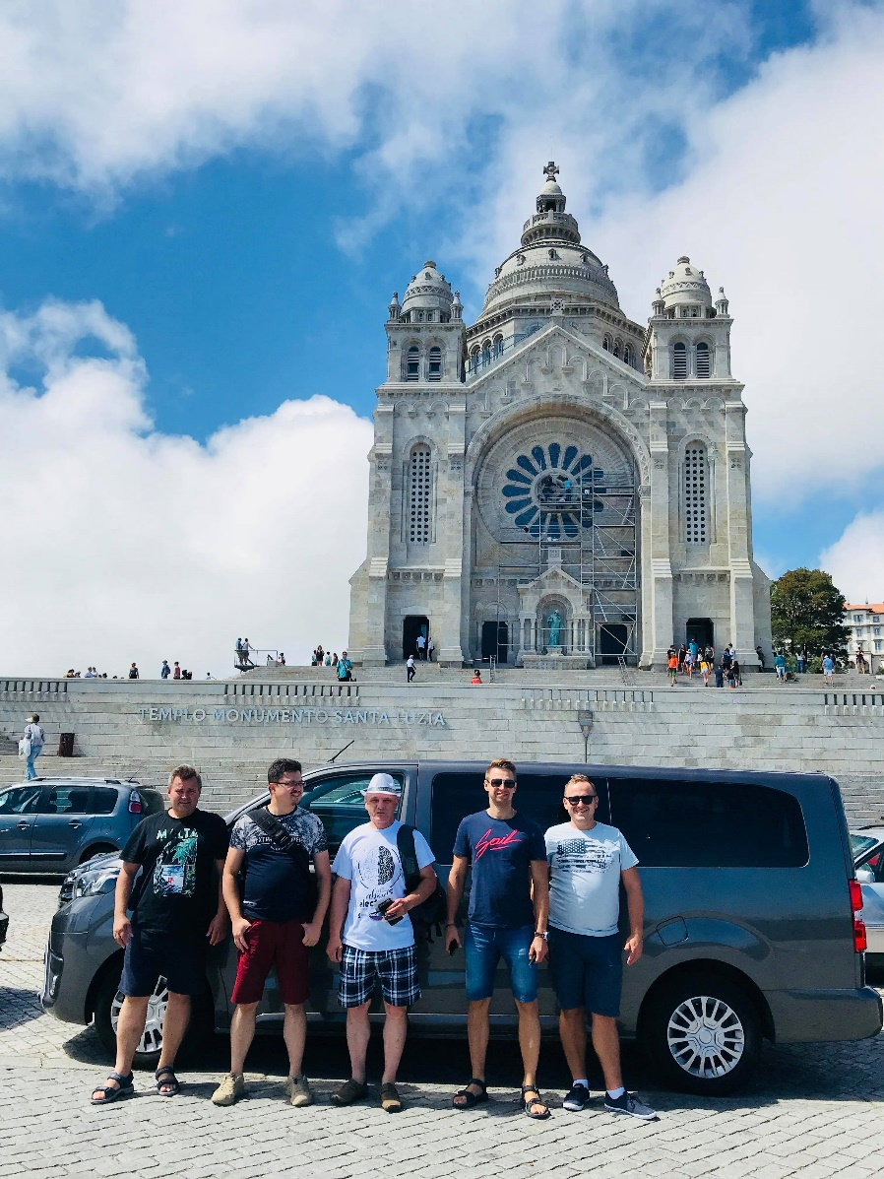
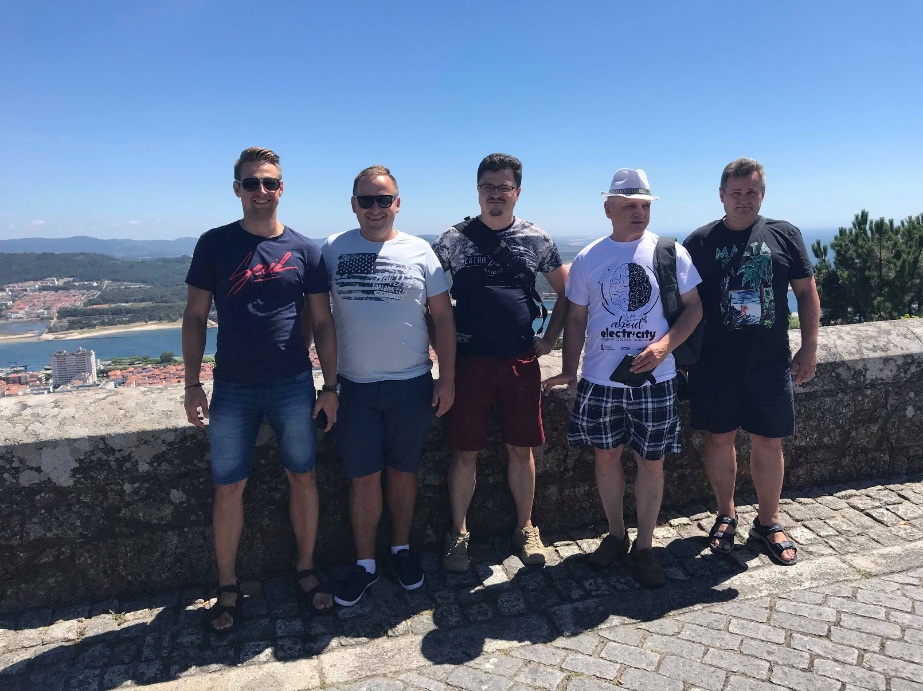
Viana do Castelo

Slide 42
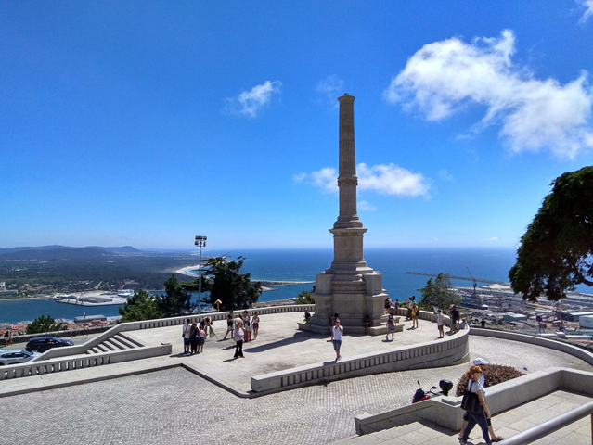
Viana do Castelo

Slide 43
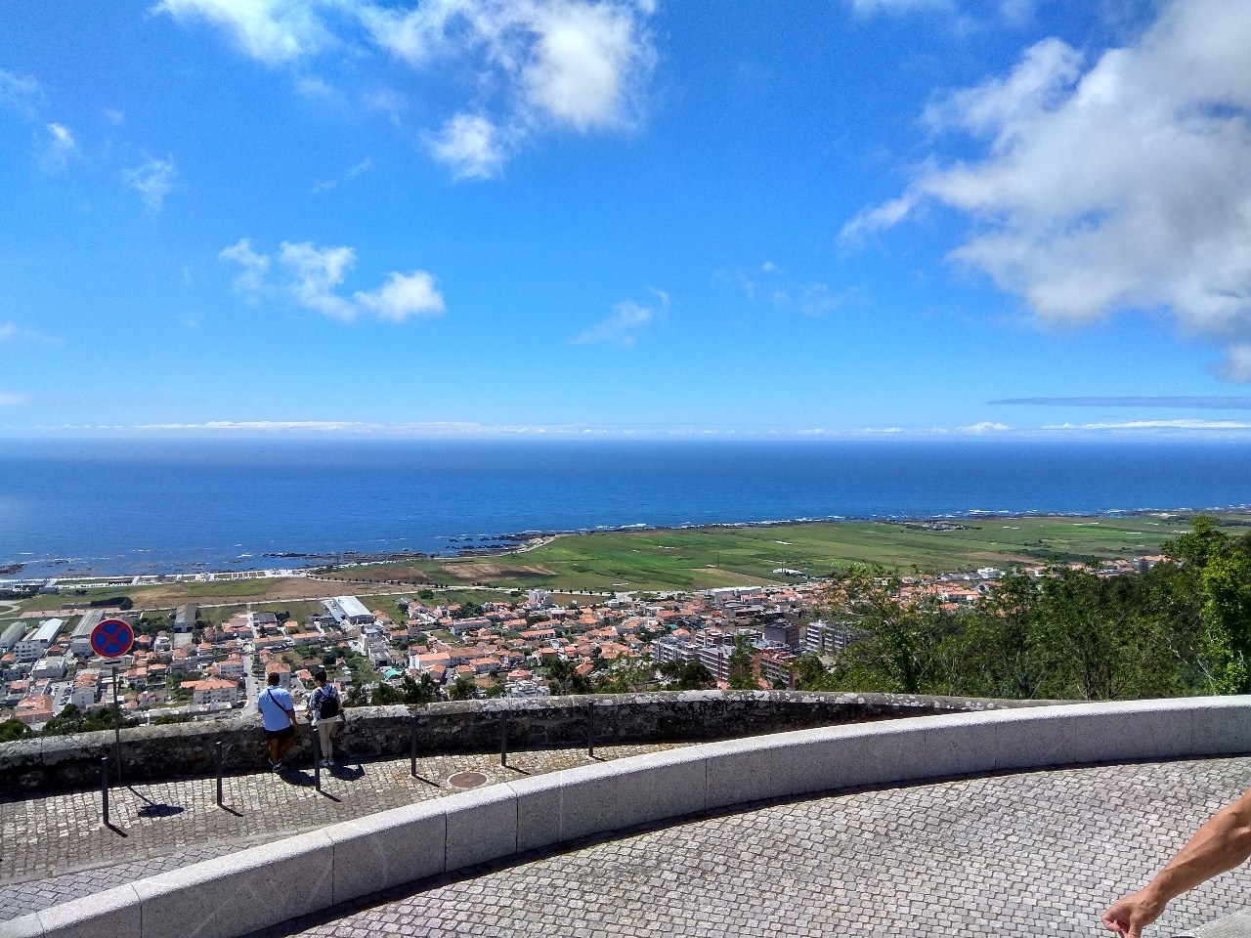
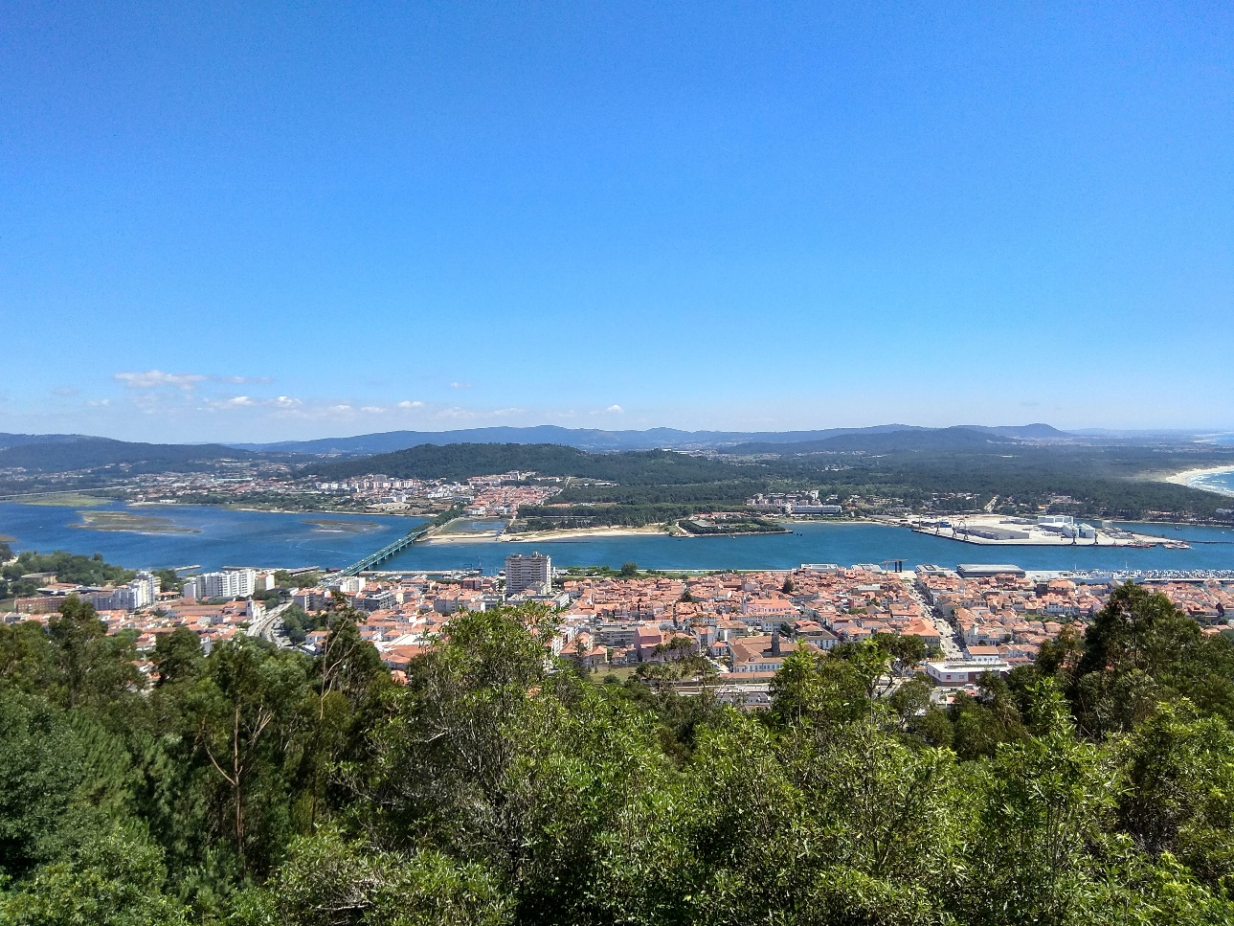
Viana do Castelo

Slide 44
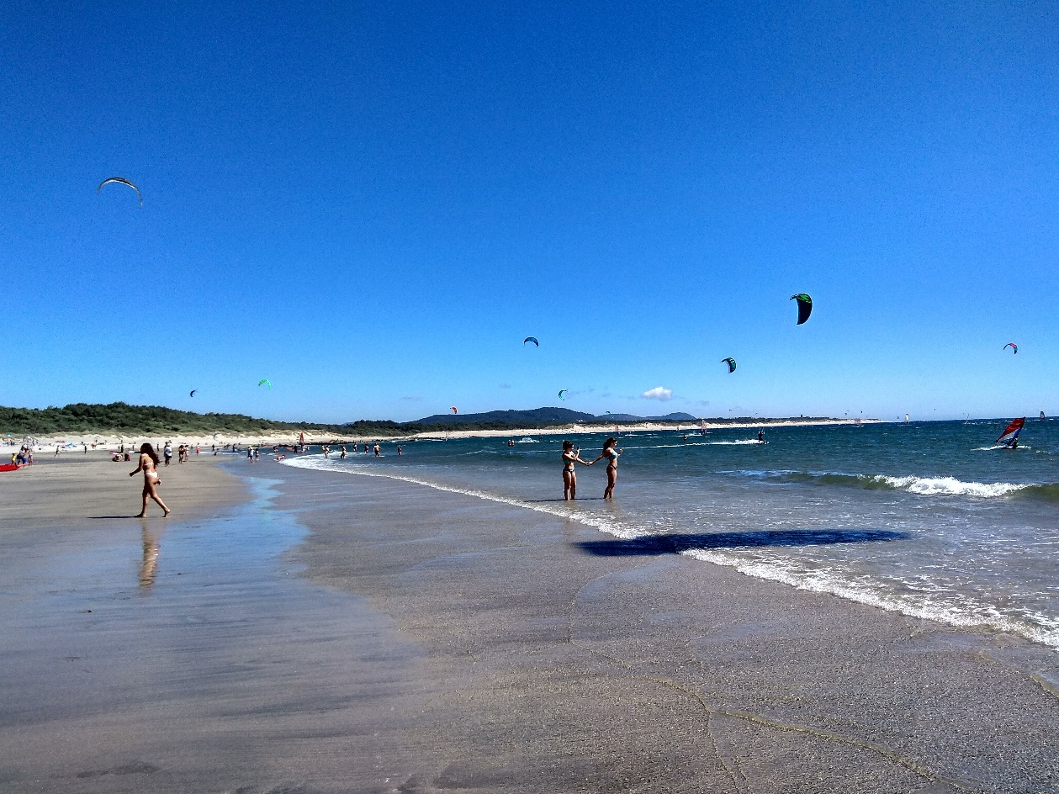
Viana do Castelo

Slide 45
Guimarães
The first capital of Portugal

Slide 46
Guimarães

Slide 47
Braga

Slide 48
Braga

Slide 49
Braga

Slide 50
Braga - Bom Jesus do Monte

Slide 51
Braga - Bom Jesus do Monte

Slide 52
Braga - Bom Jesus do Monte

Slide 53
Braga - Santuário do Sameiro

Slide 54
Porto

Slide 55
Porto

Slide 56
Porto

Slide 57
Free time

Slide 58
Relax

Slide 59
Finishing the training and returning home

Slide 60
At the end of the course we received
a hearty teacher's handshake
and certificates

Slide 61
And on the way back?
We mentioned a farewell cake
and we admired the views that were przespać

Slide 62
Summary

Slide 63
It was…
educationally

Slide 64
touristically

Slide 65
warm and picturesque
Just why so short...? ☹

Slide 66
A stay in Portugal helped us to break the language barrier, as it included, among others the need to conduct conversations in English. We have expanded the vocabulary range, but also in the areas of travel, food, drinks, health, shopping, work, daily and weekend activities.
We have gained knowledge about Portuguese culture and the education system.

Slide 67
Classes in a small group had a workshop formula and were based on interactive tasks.
Free time, spent on many hours of sightseeing was very fruitful in gaining knowledge about history, culture, monuments of Portugal.
All experiences gained while in Portugal were very valuable. Some have broadened our knowledge, which is needed every day to work with students.

Slide 68
All individual benefits that we have acquired - will translate into students and the entire school environment, which in turn will lead to an increase in the quality of teaching in our school.
We will continue to use them in our work.

Slide 69
Acquired skills and professional competences:
Using platforms presented in classes, e.g. Kahoot !, PowToon.
Deepening the ability to use English,
Getting to know a bit of Portuguese language,
Familiarizing with the structure of the Portuguese educational system,
Deepening cultural sensitivity,
Increase self-confidence by participating in diffrent culturally environment.

Slide 70
Thank you for your attention!!!
Sławek, Piotrek, Krzysiek, Romek i Marek

