Slide 1
Learning•practice•labor market

Slide 2
Course of internship
Our internship begone from mandatory safety training,getting acquainted with the job position and our responsibilities.
During the next days of stay and work, we got to know the details of the service technician position, the entire company and the job market in other countries.

Slide 3
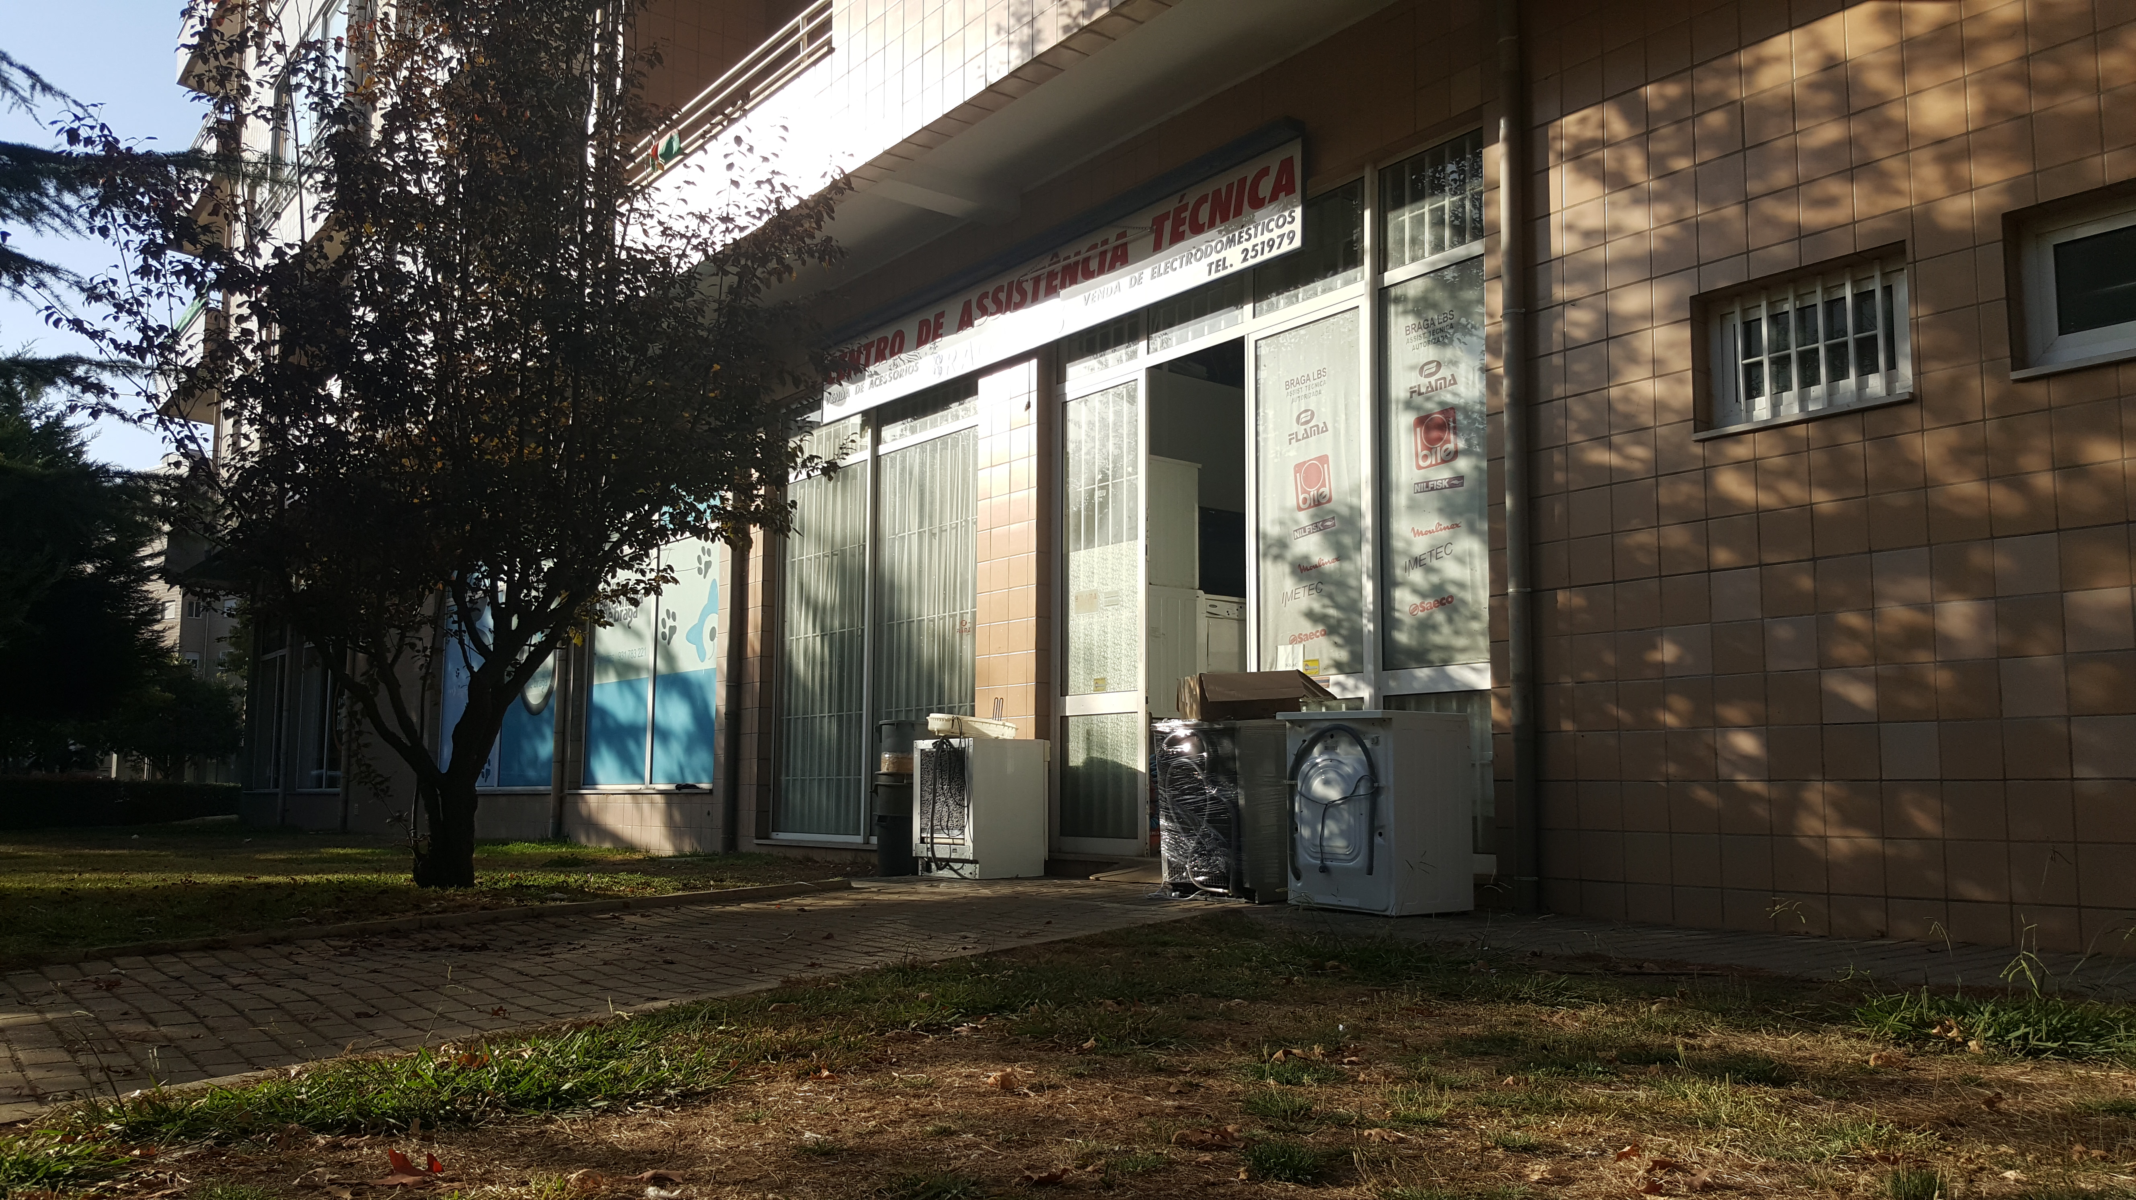
Braga LBS-Centro de Assistência Técnica
Braga LBS was the place of our internships. A small company based in the city of Braga in Portugal

Slide 4
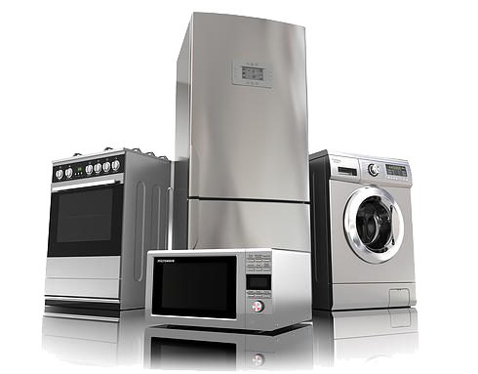
More about Braga LBS
Company deals with servicing and repairing household appliances. The equipment is delivered by the customers themselves to the service point or the employee is dispatched to the customer.

Slide 5
Braga LBS is a private company,working in service and repair sector.Company have local coverage and operates in the area of one city
We can classify this company as small with fewer than 5 employees
The company has many years of experience and good reputation

Slide 6
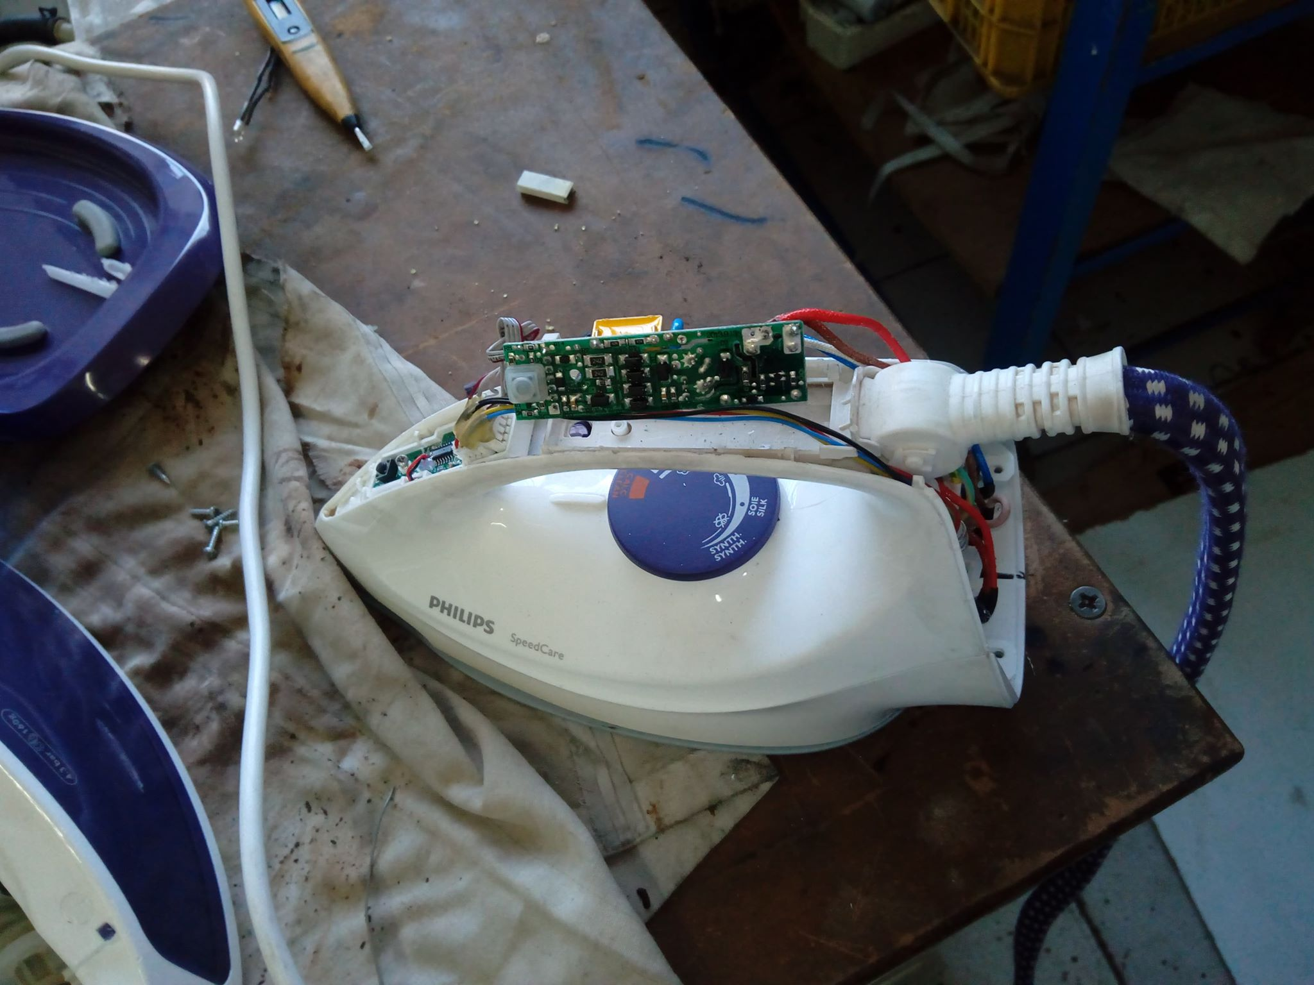
Services
Repair of small household appliances such as:
microwaves
coffee makers
Irons
dryers
Repair of big household appliances such as:
refrigerators
freezers
gas furnaces
washing machines

Slide 7
Workplace
It contains many tools and devices needed at particular stages of work:
- Disassembly and assembly:
screwdrivers
pliers
Soldering iron
cutters
- diagnostics and tests:
multimeters
temperature meters
power connections with protection

Slide 8
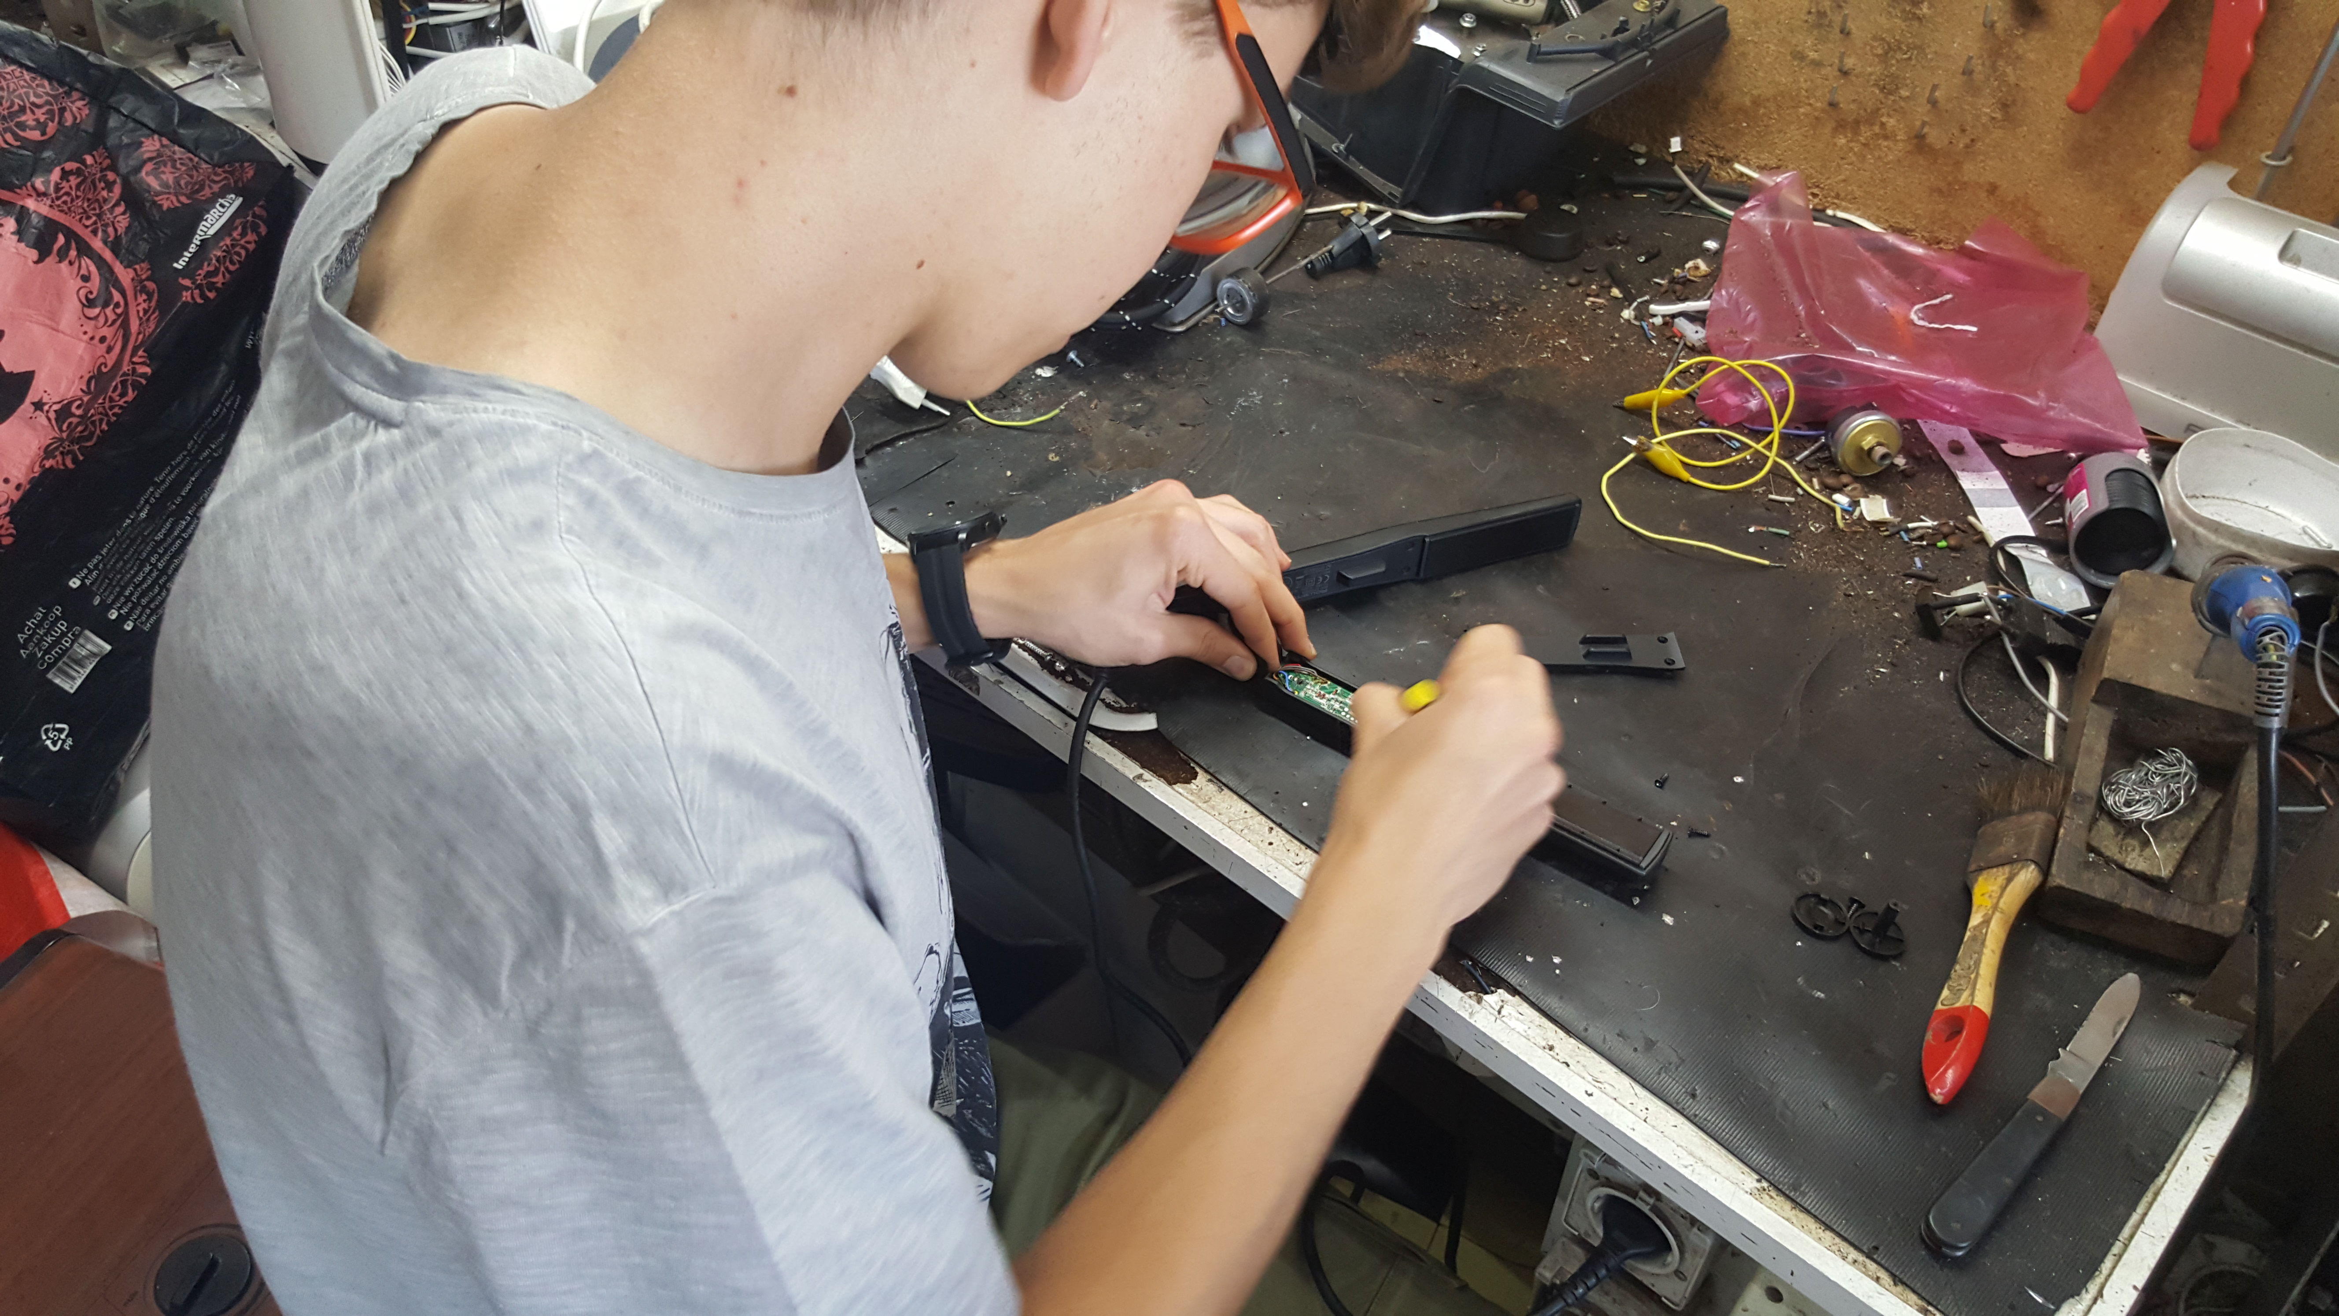
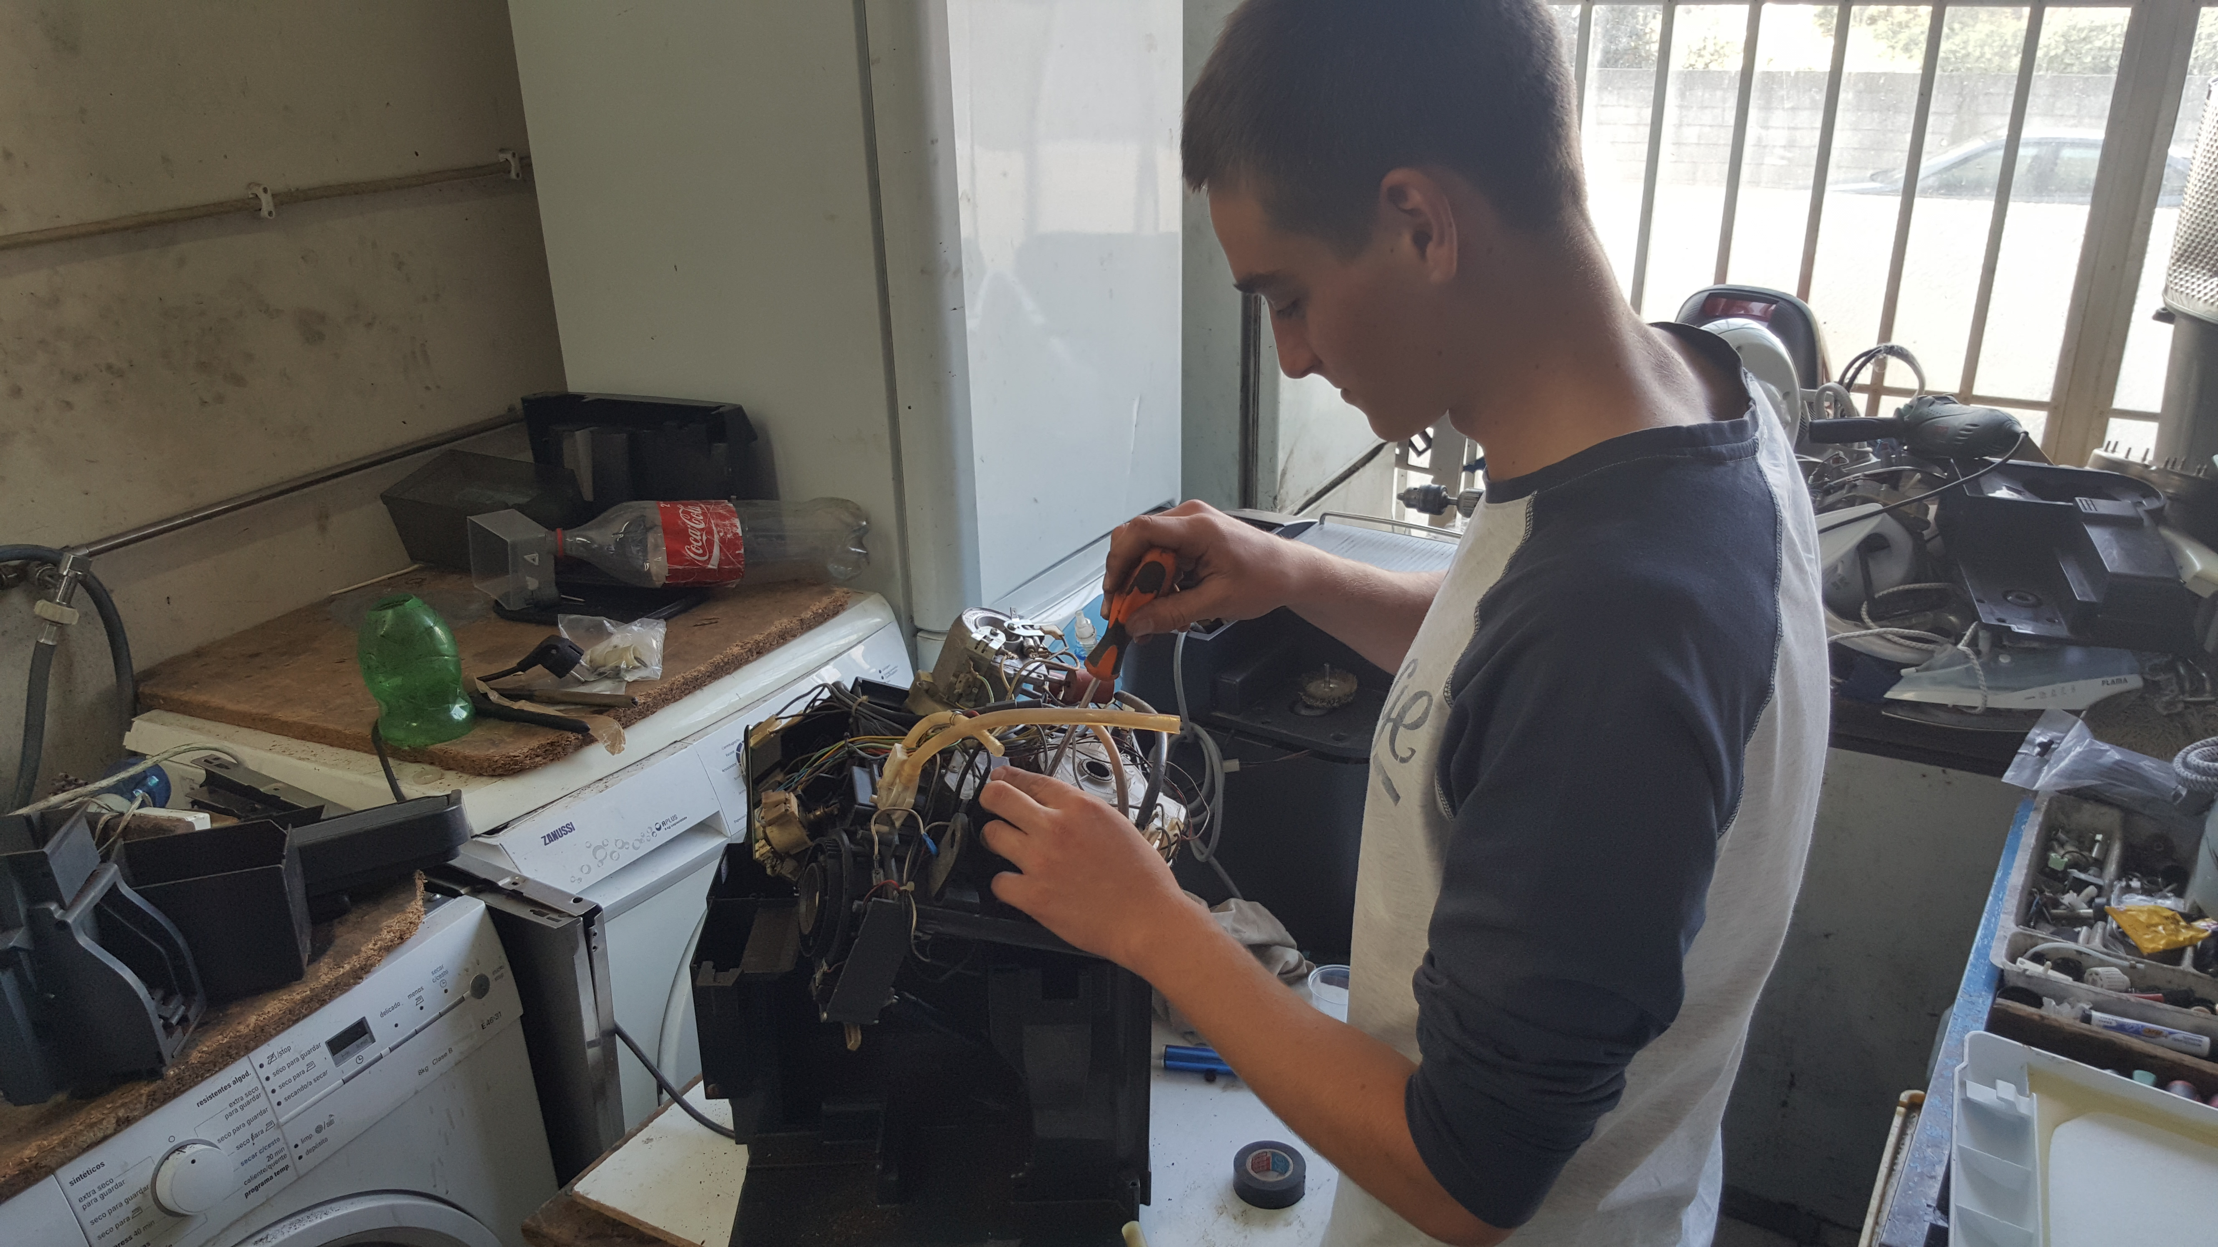
Performing service activities

Slide 9
Employment
Most of the employees were relatively young. The work in Braga LBS you have to finish high school and have alot of willingness to work. All necessary trainings in the field of safety and service will be carried out in the company.

Slide 10
Characteristics of the owner
The owner of the Braga LBS was a very nice and friendly person,had a lot of technical experience. He had great contact with customers and employees.

Slide 11
Ecology
The company, thanks to the repair of damaged or broken equipment, contributes to reducing the amount of plastic and electronic waste in landfills. A positive surprise for us was the number of people interested in repairing the equipment instead of buying a new one, it is a very positive social phenomenon that protects the environment and also creates new jobs.

Slide 12
Salary
We have not received any specific number but a new employee starting work requiring training will receive a payment around the national minimum, the pay will rise with experience and time worked in the company.

Slide 13
Customer characteristics
Our observations and conversations show that customers like to use services such as home appliances repairs not only to save some money but also by wanting to reduce waste and use the full potential of the devices for which they paid.

Slide 14
Competition in the industry
Competition in the repair industry and servicing not only of household appliances but also computers and small electronics is relatively high due to the interest of customers. Most of the companies operating in this industry are small companies with a local range, which further increases competition.

Slide 15
THE END
Presentation created by Jakub Tymiński

